Slide 1

BEGINNERS’ LESSONS
Welcome
Teacher: Your Name Here
Telephone: 123 4567
Email: email@address.co.nz
Prepared by Amanda Smith

Slide 2
Lesson Two
1-Level Opening Bids

Slide 3



Ranking of the Suits
NoTrumps
Spades ♠
Hearts ♥
Diamonds ♦
Clubs ♣
MAJOR suits
MINOR suits
Notes:
Emphasise Major / NoTrumps / Minor ... Talk about this as often as possible

Slide 4


Finding a Fit
A Fit is 8+ cards in one suit
If there is a fit in a major this will be the trump suit
If there is no fit, then choose NoTrumps

Slide 5


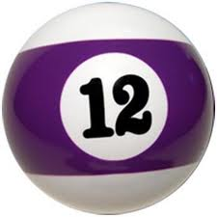
Levels of Bidding
The number of tricks you must make to get a
score = 6 + the level bid
  1-level contracts ... Must make 6 + 1 = 7 tricks
  2-level contracts ... Must make 6 + 2 = 8 tricks
  3-level Contracts ... Must make 6 + 3 = 9 tricks
  etc
  4-level Contracts ... Must make tricks?
  6-level Contracts ... Must make tricks?

Slide 6

The Auction
Every suit has a ranking order
Each bid must be higher than the previous bid
1♣ | 1♦ | 1♥ | 1♠ | 1NT
2♣ | 2♦ | 2♥ | 2♠ | 2NT
3♣ | 3♦ | 3♥ | 3♠ | 3NT
4♣ | 4♦ | 4♥ | 4♠ | 4NT
etc
The first person to bid is the Opener
Opener’s partner is the Responder

Slide 7
Basic Rules for Opening 1-suit
You must have enough High Card Points
12-19

Slide 8
Basic Rules for Opening 1-suit
12-19
Q = 2
A = 4
K = 3
J = 1

Slide 9
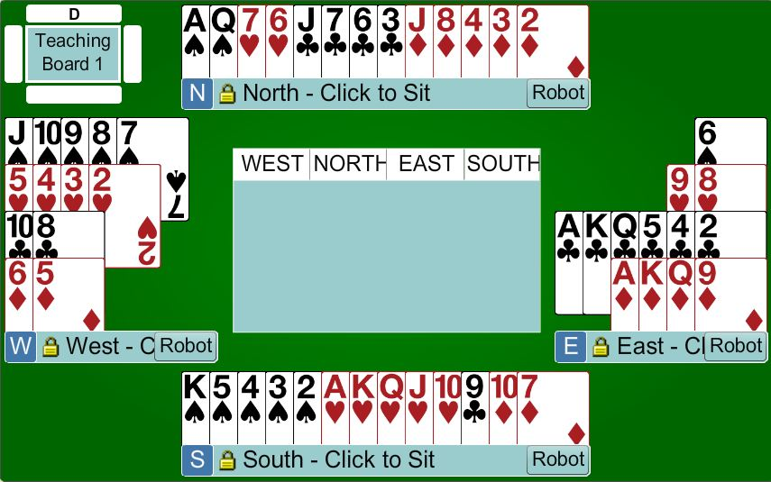
Which hand can open the bidding?

Slide 10
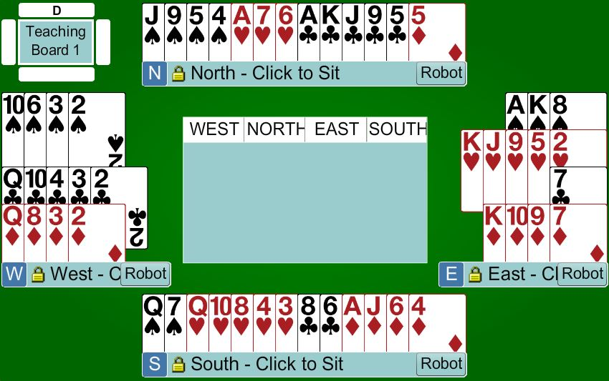
Which hand can open the bidding?

Slide 11
Opener’s First Bid
 | Points | Description
1♣ | 12 - 19 | 4 + clubs
1♦ | 12 – 19 | 4 + diamonds
1♥ | 12 – 19 | 4 + hearts
1♠ | 12 – 19 | 4 + spades
1NT | 12 – 14 | Balanced hand ... SPECIAL CASE

Slide 12

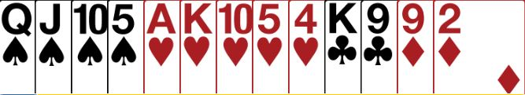
Rules for 1-level suit openings
Bid your longest suit first

Slide 13


Basic Rules for 1-level suit openings
Bid your lower ranking 4-card suit first

Slide 14
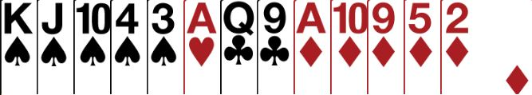

What do you open?
Bid your higher ranking 5-card suit first

Slide 15
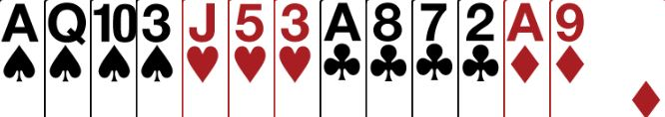
Quiz … what do you open?
Open 1♣
… open your lower ranking 4-card suit first

Slide 16
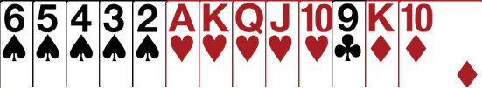
Quiz … what do you open?
Open 1♠
… open your higher ranking 5-card suit first

Slide 17
Further Bidding ... To come in more detail
Responder needs 6 + points to bid ... ½ of what Opener needs
Try to find a Fit as soon as possible
There are 3 choices of level
  Minimum (6 – 9)
  Close to Game (10 – 12)
  Enough for Game (13+)
If there is NO fit, then bid notrumps
To bid Game you need 25+ points between the two hands
What Next?

Slide 18
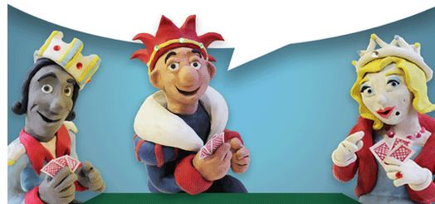

Practice Online
Go to www.skybridgeclub.com
Follow the instructions in the Welcome Pack
REMEMBER to change your bidding system
Follow the notes to see what to bid (after the opening bid
Play the hands … these are the ones we have played tonight.
You can play the hands as often as you want
Practice playing the hands different ways to see what happens

Slide 19
Summary for 1-level suit openers
12-19
Open with 12-19 points
Bid your longest suit first
If you have two 4-card suits bid the lower ranked suit first
If you have two 5-card suits bid the higher ranked suit first
Suit quality does not matter

Slide 20
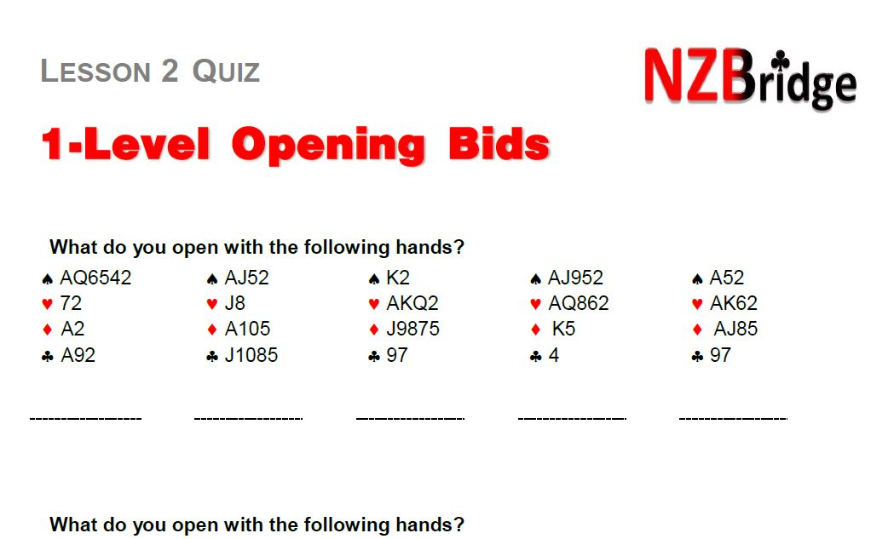
Homework (sorry)

Slide 21

BEGINNERS’ LESSONS
Please contact me if you have any questions
Teacher: Your Name Here
Telephone: 123 4567
Email: email@address.co.nz
Notes:
Demonstrate playing of cards … get them to play one board … no interference

