Slide 1

BEGINNERS’ LESSONS
Welcome
Teacher: Your Name Here
Telephone: 123 4567
Email: email@address.co.nz
Prepared by Amanda Smith

Slide 2
Lesson Three
Responder’s Limit Bids

Slide 3
NOT NEXT - RECAP

Slide 4



Ranking of the Suits
NoTrumps
Spades ♠
Hearts ♥
Diamonds ♦
Clubs ♣
MAJOR suits
MINOR suits
Notes:
Emphasise Major / NoTrumps / Minor ... Talk about this as often as possible

Slide 5

Finding a Fit
A Fit is 8+ cards in one suit between the two hands
If there is a fit in a major suit, then this will be the trump suit
If there is no fit, then choose NoTrumps

Slide 6
START AGAIN HERE

Slide 7

Basic Rules for Opening bids
You must have enough High Card Points
12-19

Slide 8
Basic Rules for Responder’s bids
You must have enough High Card Points
6
or more
½ the amount of points you need to open

Slide 9
Basic Rules for Responder’s bids
1. Support partner’s suit
2. Bid a new suit (next week’s lesson)
3. Bid NoTrumps … the bid of last resort
You have 3 choices

Slide 10
Responder’s Limit bids
Support partner’s suit
Bid NoTrumps … this is the bid of last resort
These are limit bids
… they are NOT FORCING

Slide 11
FIRST CHOICE: Support Partner’s suit
Minimum (6-9) … bid at the 2-level
Nearly game (10-12) … bid at the 3-level
Game (13+) … bid at the Game level
These are limit bids
… they are NOT FORCING

Slide 12
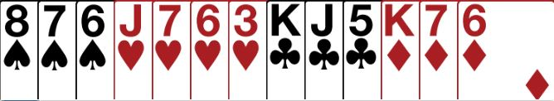
Partner Opens 1♥ … what do you bid
6 - 9 points … with a fit
Bid 2 ♥ … MINIMUM

Slide 13
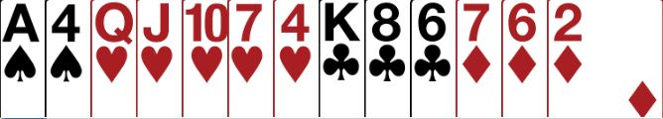
Partner Opens 1♥ … what do you bid
10 – 12 points … with a fit
Bid 3♥ … CLOSE TO GAME

Slide 14
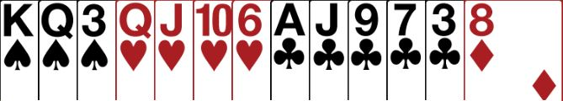
Partner Opens 1♥ … what do you bid
13+ points … with a fit
Bid 4♥ … GAME

Slide 15
LAST RESORT: Bid NoTrumps
Minimum (6-9) … bid 1NT
Nearly game (10-12) … bid 2NT
Game (13-15) … bid 3NT
These are limit bids … they are NOT FORCING

Slide 16
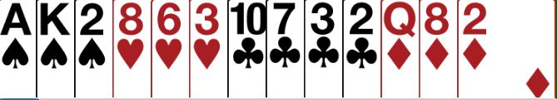
Partner Opens 1♥ … what do you bid
No fit in hearts
∴with 6-9 points …. MUST bid 1NT

Slide 17
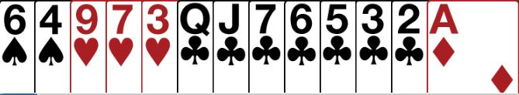
Partner Opens 1♥ … what do you bid
No fit in hearts
∴with 6-9 points …. MUST bid 1NT

Slide 18


Partner Opens 1♥ … what do you bid
No fit in hearts
∴with 10-12 points …. MUST bid 2NT

Slide 19
Opener’s REBID after 2-level (6-9) raise
OPENER | HCP | ACTION
Minimum | 12 – 15 | PASS
Close to Game | 16 – 17 | INVITE (bid 3)
GAME | 18 – 19 | BID GAME

Slide 20
Opener’s REBID after 3-level raise
OPENER | HCP | ACTION
Minimum | 12 – 13 | PASS
GAME | 14+ | BID GAME

Slide 21
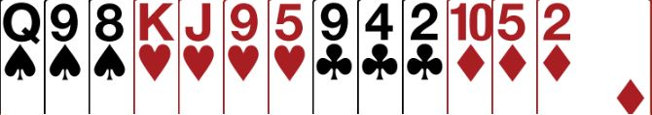
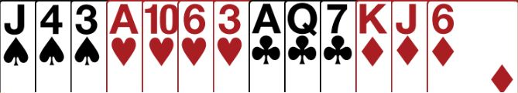
Opener’s Rebid
Bid
2♥
Open 1♥ then PASS
Open
1♥

Slide 22

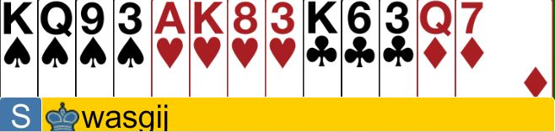
Opener’s Rebid 6 + 17
Bid
2♥
Open 1♥ then rebid 3♥
Open
1♥

Slide 23

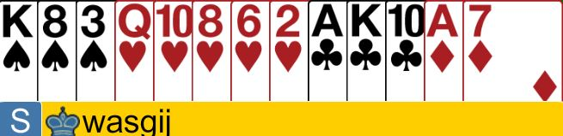
Opener’s Rebid
Bid
3♥
Open 1♥ then rebid 4♥
Open
1♥

Slide 24
Opener’s REBID after 1NT response (6-9)
OPENER | HCP | ACTION
Minimum | 12 – 15 | Pass Bid lower new suit Rebid own suit
Close to Game | 16 – 17 | Bid new suit Bid 2NT Jump in own suit (6+)
GAME | 18 – 19 | BID GAME Bid 3NT Bid 4 Major (6+)

Slide 25
Opener’s REBID after 2NT response (10-12)
OPENER | HCP | ACTION
Minimum | 12 – 13 | Pass Rebid own suit (6+)
GAME | 14 + | Bid new suit Bid 3NT Bid 4 Major (6+)

Slide 26

BEGINNERS’ LESSONS
Please contact me if you have any questions
Teacher: Your Name Here
Telephone: 123 4567
Email: email@address.co.nz
Notes:
Demonstrate playing of cards … get them to play one board … no interference

