Slide 1

BEGINNERS’ LESSONS
Welcome
Teacher: Your Name Here
Telephone: 123 4567
Email: email@address.co.nz
Prepared by Amanda Smith

Slide 2
Lesson Four
Responder’s New Suit Bids

Slide 3
Basic Rules for Responder’s bids
1. Support partner’s suit
2. Bid a new suit
3. Bid NoTrumps … this is the bid of last resort
You have 3 choices

Slide 4
New Suit Bids by Responder
1-level bid = 6+ HCP
2-level bid = 10+ HCP
(Don’t jump to the 2-level if you can bid at the 1-level)
These bids are unlimited
they are FORCING
partner MUST bid again

Slide 5
Which Suit do you bid?
1. Longest suit
2. Lower available 4-card suit
3. Higher ranking 5-card suit
These bids are unlimited
they are FORCING
partner MUST bid again

Slide 6
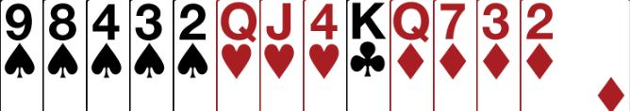
Partner Opens 1♥ … what do you bid
No fit in hearts, with 6+ points
Bid 1♠ … bid own suit at 1-level

Slide 7
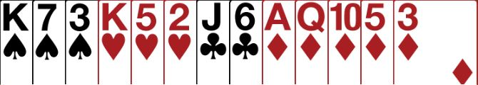
Partner Opens 1♥ … what do you bid
No fit in hearts, with 10+ points
Bid 2♦ … bid own suit at 2-level

Slide 8

Partner Opens 1♥ … what do you bid
No fit in hearts, with 6+ points
But not enough points to bid 5-card suit
Bid 1♠ … bid own suit at 1-level

Slide 9
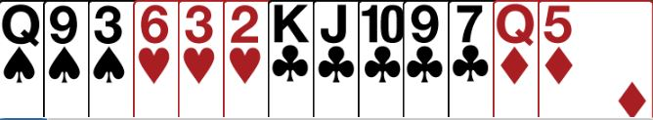

Partner Opens 1♥ … what do you bid
No fit in hearts
Cannot bid own suit at 1-level
Not enough points to bid at the 2-level
∴MUST bid 1NT … the bid of last resort

Slide 10

Basic Rules for Opener’s Rebid
Agree partner’s suit if you have a fit
Bid NoTrumps
Bid another suit (if you can)
Bid your suit again (with extra length)
AND AT THE SAME TIME
Describe the quality of your hand
  MINIMUM, NEARLY GAME or GAME

Slide 11
What type of hand have you got?
18 – 19 | GAME
16 - 17 | Nearly Game
12 - 15 | Minimum

Slide 12
Support Responder’s Suit
MINIMUM (12-15) … raise a level
INVITATIONAL (16-17) … jump a level
GAME (18-19) … bid game
MUST HAVE A FIT
4+ support

Slide 13
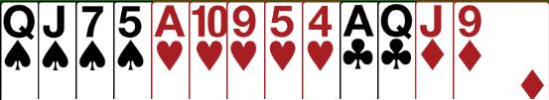
Opener’s Rebid – SUPPORT PARTNER
You open 1♥
Partner bids 1♠
You have a fit, 14 HCP
MINIMUM HAND – Bid 2♠

Slide 14

Opener’s Rebid – SUPPORT PARTNER
You open 1♦
Partner bids 1♥
You have a fit, 16 HCP
NEARLY GAME (INVITATIONAL) – Bid 3♥

Slide 15

Opener’s Rebid – SUPPORT PARTNER
You open 1♣
Partner bids 1♠
You have a fit, 19 HCP
GAME – Bid 4♠

Slide 16
Bid NoTrumps
LOWEST LEVEL NT = 15 – 17 HCP
JUMP IN NT = 18 – 19 HCP
(forcing to game)
Shows a balanced hand

Slide 17
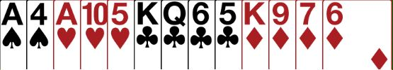
Opener’s Rebid – BID NOTRUMPS
You open 1♣
Partner bids 1♠
You have a balanced hand with no fit, 16HCP
LOWEST LEVEL NT - Bid 1NT

Slide 18

Opener’s Rebid – BID NOTRUMPS
You open 1♦
Partner bids 2♣
You have a balanced hand with no fit, 16 HCP
LOWEST LEVEL NT - Bid 2NT

Slide 19

Opener’s Rebid – BID NOTRUMPS
You open 1♦
Partner bids 1♥
You have a balanced hand with no fit, 18HCP
JUMP IN NT - Bid 2NT

Slide 20
Opener’s Rebid – BID NOTRUMPS
You open 1♦
Partner bids 2♣
You have a balanced hand with no fit, 18 HCP
JUMP IN NT - Bid 3NT

Slide 21
Bid a New Suit
2 OF NEW SUIT = 12 – 17 HCP
3 OF NEW SUIT = 18 – 19 HCP
(forcing to game)
Shows an unbalanced hand
Shows 5+cards in first suit and 4+cards in second suit

Slide 22

MINIMUM HANDS – 12 - 15
DO NOT bid past your original opening suit (the barrier)
12 – 15 | Minimum

Slide 23

Opener’s Rebid – BID A NEW SUIT
You open 1♥
Partner bids 1♠
No fit with partner, unbalanced, 13 HCP
MINIMUM – bid new suit BELOW 1st suit – Bid 2♣

Slide 24

Opener’s Rebid – BID A NEW SUIT
You open 1♦
Partner bids 1♠
No fit with partner, unbalanced, 12 HCP
MINIMUM – CANNOT BID HEARTS
Rebid 1st suit – Bid 2♦

Slide 25

Opener’s Rebid – BID A NEW SUIT
You open 1♥
Partner bids 1♠
No fit with partner, unbalanced, 19 HCP
GAME – MUST BID PAST THE BARRIER
Jump in second suit – Bid 3♦

Slide 26
Rebid Your Own Suit
2-level = 12-15 HCP
Jump = 16-17HCP (6+)
GAME = 18-19 HCP (6+)
Usually shows a single
suited hand

Slide 27

Opener’s Rebid – REBID OWN SUIT
You open 1♦
Partner bids 1♠
No fit with partner, unbalanced, 12 HCP
MINIMUM
Rebid your own suit – Bid 2♦

Slide 28

Opener’s Rebid – REBID OWN SUIT
You open 1♥
Partner bids 1♠
No fit with partner, unbalanced, 16 HCP
NEARLY GAME (INVITATIONAL)
Rebid your own suit – Bid 3♥

Slide 29

Opener’s Rebid – REBID OWN SUIT
You open 1♠
Partner bids 2♣
No fit with partner, unbalanced, 17 HCP
GAME (partner has 10+ points), 6+ own suit
Bid GAME in your suit – Bid 4♠

Slide 30

BEGINNERS’ LESSONS
Please contact me if you have any questions
Teacher: Your Name Here
Telephone: 123 4567
Email: email@address.co.nz
Notes:
Demonstrate playing of cards … get them to play one board … no interference

