Slide 1

BEGINNERS’ LESSONS
Welcome
Teacher: Your Name Here
Telephone: 123 4567
Email: email@address.co.nz

Slide 2
Lesson Five
Balanced Hands

Slide 3

Opener’s First Bid
 | Points | Description
1♣ | 12 - 19 | 4 + clubs
1♦ | 12 – 19 | 4 + diamonds
1♥ | 12 – 19 | 4 + hearts
1♠ | 12 – 19 | 4 + spades
1NT | 12 – 14 | Balanced hand ... SPECIAL CASE

Slide 4
Basic Rules for Opening 1NT
12 - 14 points
Balanced Hand
This bid is your FIRST choice from now on

Slide 5

What is a balanced hand?
No singleton or void
Only one doubleton
No 5-card major
Shapes = 4333, 4432, 2335
Balanced hands are the most common

Slide 6

Balanced or Not?
No singleton or void
Only one doubleton
No 5-card major

Slide 7
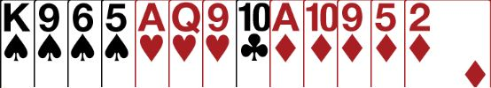

Balanced or Not?
No singleton or void
Only one doubleton
No 5-card major

Slide 8

Balanced or Not?
No singleton or void
Only one doubleton
No 5-card major

Slide 9
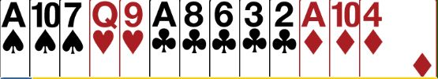
Balanced or Not?
No singleton or void
Only one doubleton
No 5-card major

Slide 10

Balanced or Not?
No singleton or void
Only one doubleton
No 5-card major

Slide 11
Balanced or Not?
Open 1♠
Open 1NT

Slide 12

What does responder do?
Do you want to play in NoTrumps or a suit?
Have you got enough points to bid or invite game?
Responder is the BOSS
There are ONLY 2 decisions to make

Slide 13
Responses to 1NT – Balanced Hand
0 – 10 points … no GAME possible … PASS
11 – 12 points … GAME is possible … Bid 2NT
13+ points … definitely in GAME … Bid 3NT
Add your points to partner’s KNOWN 12-14 points

Slide 14
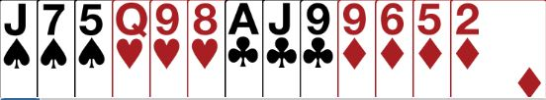
What does responder do?
PASS … not enough for GAME
NoTrumps or a suit?
What level?

Slide 15

What does responder do?
Bid 3NT … enough for GAME
NoTrumps or a suit?
What level?

Slide 16
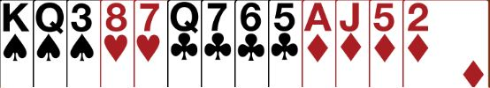
What does responder do?
Bid 2NT … invite to GAME
NoTrumps or a suit?
What level?

Slide 17

Responses to 1NT – Unbalanced Hand
0 – 10 points … no GAME possible
  Bid your + card suit at the 2-level
  This is a WEAK TAKEOUT
  Partner MUST then pass … YOU ARE THE BOSS
Add your points to partner’s KNOWN 12-14 points

Slide 18


Responses to 1NT – Unbalanced Hand
12+ points … GAME Forcing
  Bid your card MAJOR at the 3-level
  (Partner MUST agree your suit or bid NoTrumps)
  Bid your card MAJOR at the 4-level - OR
  Bid your card MINOR at the 5-level

Slide 19
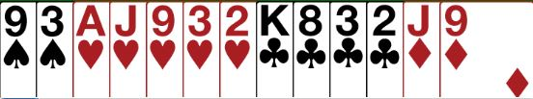
What does responder do?
Bid 2♥… not enough for GAME
Opener MUST pass

Slide 20
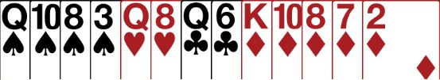
What does responder do?
Bid 2♦… not enough for GAME
OPENER must pass

Slide 21

What does responder do?
Bid 4♠… enough for GAME … known fit
There is a guaranteed fit

Slide 22
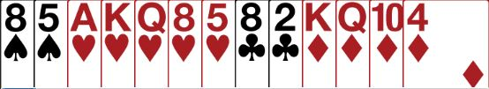

What does responder do?
Bid 3♥… enough for GAME … need to check if there is a heart fit
Opener chooses 3NT or
4 ♥ (with a fit)

Slide 23

BEGINNERS’ LESSONS
Please contact me if you have any questions
Teacher: Your Name Here
Telephone: 123 4567
Email: email@address.co.nz

