Slide 1

BEGINNERS’ LESSONS
Welcome
Teacher: Your Name Here
Telephone: 123 4567
Email: email@address.co.nz

Slide 2
Lesson Seven
Overcalls

Slide 3

Reasons for Overcalling
To get into the bidding … make it hard for the opposition
Express a genuine desire to play in a suit
Suggest a lead for partner

Slide 4

Rules to Overcall a suit
MUST be a good 5+ card suit – at least 2 honours
Point count should be close to opening values if overcalling
at the 2-level

Slide 5
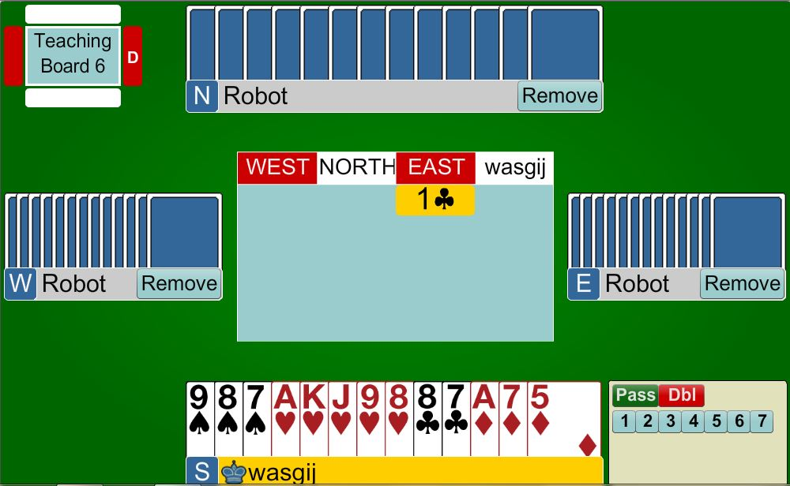
1♥
Opening Hand with GOOD 5-card suit (at least two honours in the suit)

Slide 6
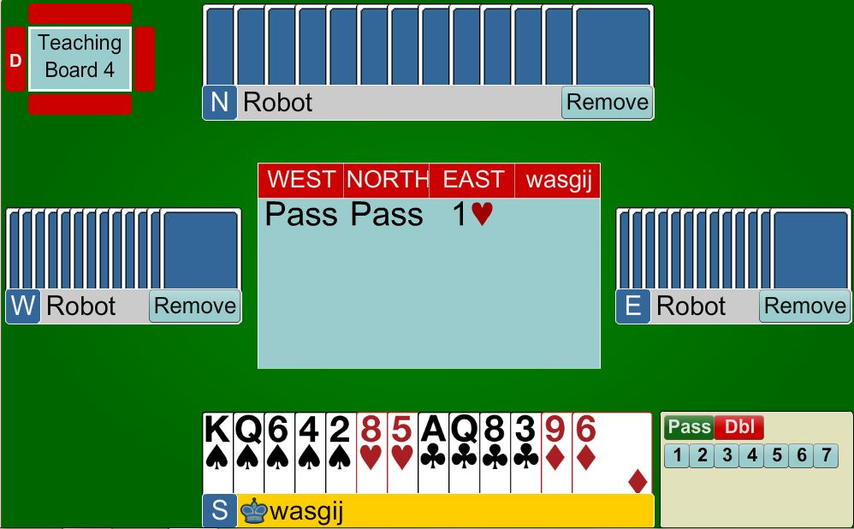
1♠
Close to opening Hand with GOOD 5-card suit (at least two honours in the suit)

Slide 7
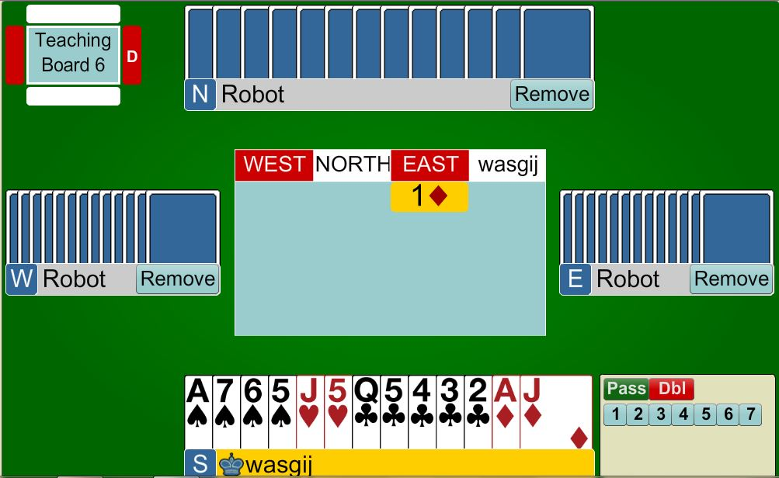
PASS
Opening Hand BUT a terrible suit … DO NOT BE TEMPTED to overcall

Slide 8
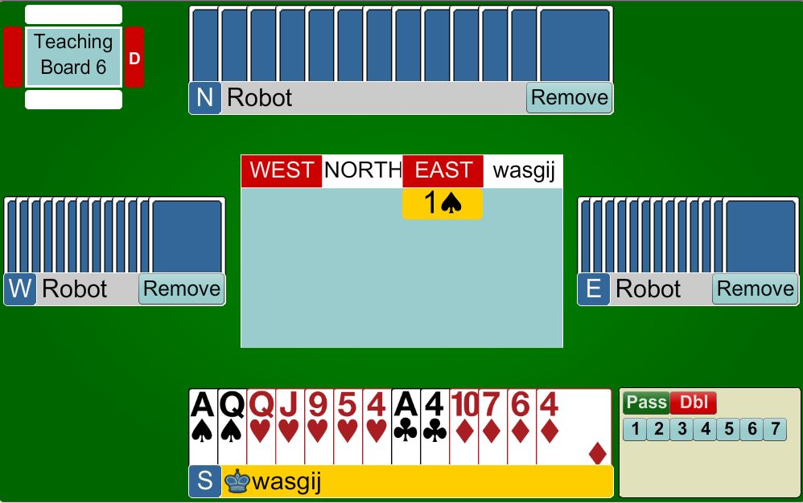

2♥ or PASS
Opening Hand with an OK suit (not great) … bidding will make it very difficult for the opposition but is quite risky

Slide 9

Response to Overcall of a suit
Only bid with a fit (3+ support)
Support partner if you can … keeping
in mind that partner has shown
of the suit – need 6+ points
With 12+ points, jump in partner’s suit

Slide 10
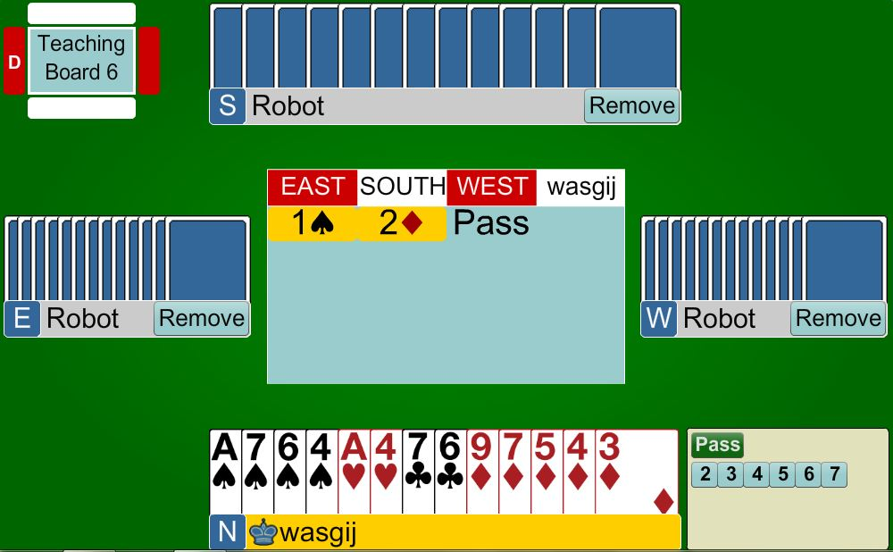
3♦
Show a minimum raise … mainly to make it as hard as possible for the opposition … you have a 10-card fit in diamonds

Slide 11
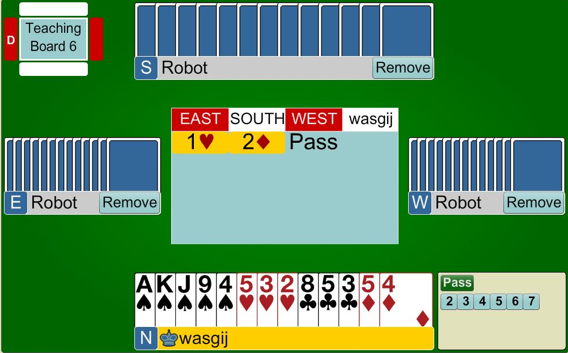
PASS
Cannot support diamonds … DO NOT bid the spade suit as your hand is not good enough.

Slide 12
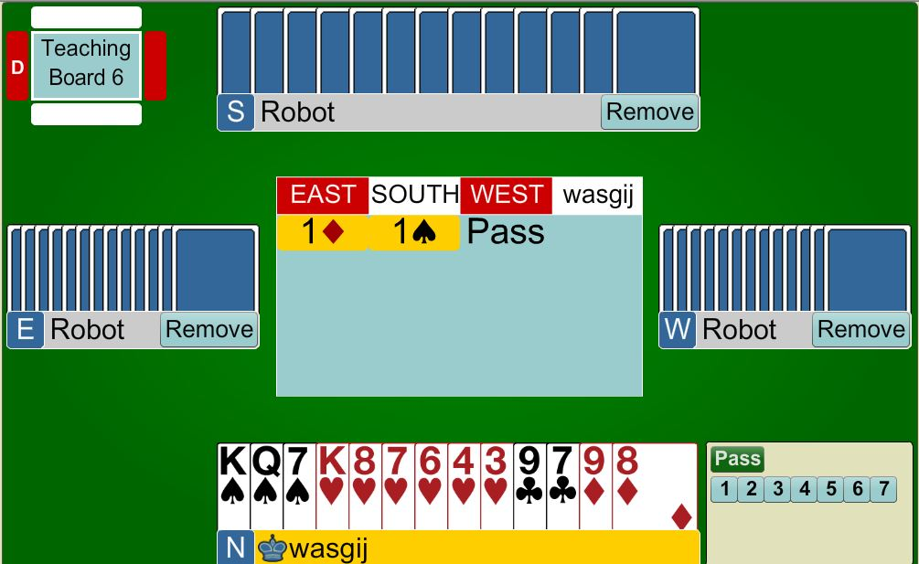
2♠
Support partner’s 5-card spade suit … you have a fit … ignore your own heart suit

Slide 13
Rules to Overcall in NoTrumps
Need BETTER points than an opening 1NT
  16 – 18 points
MUST have a cover in the
opposition’s suit

Slide 14
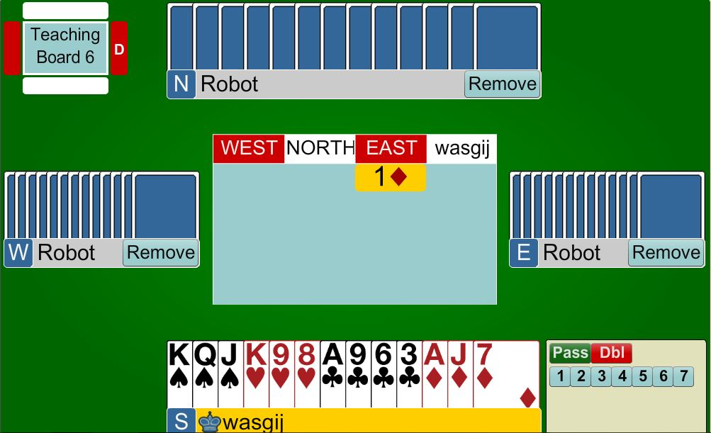
1NT
18 points, balanced hand with a diamond hold

Slide 15
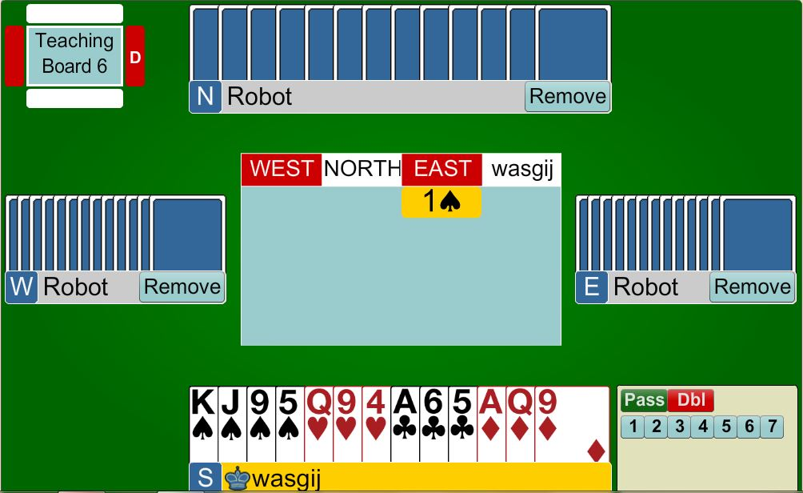
1NT
16 points, balanced hand with a spade hold

Slide 16
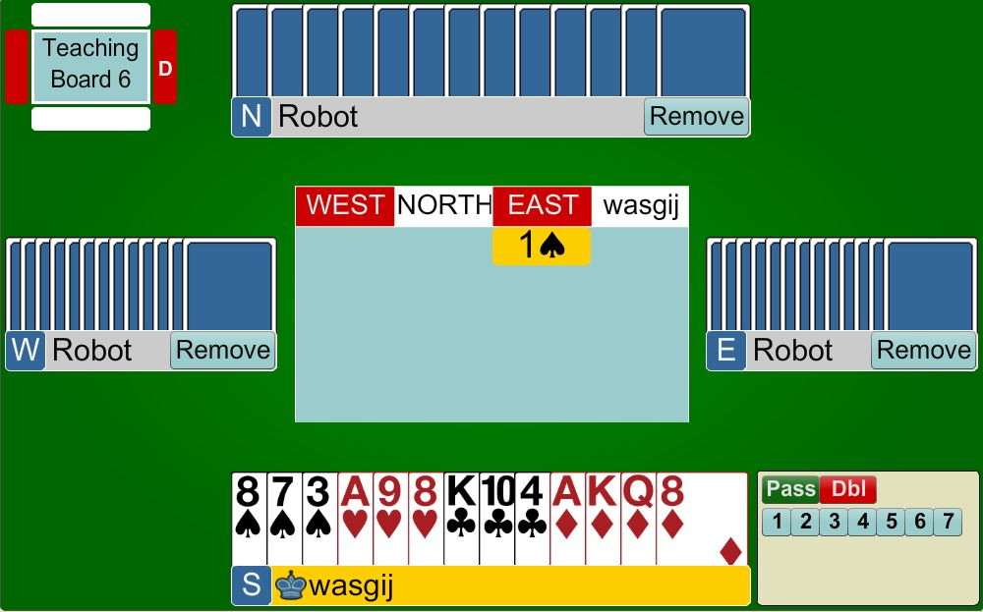
PASS
16 points, balanced hand BUT no Spade hold … so cannot bid 1NT

Slide 17
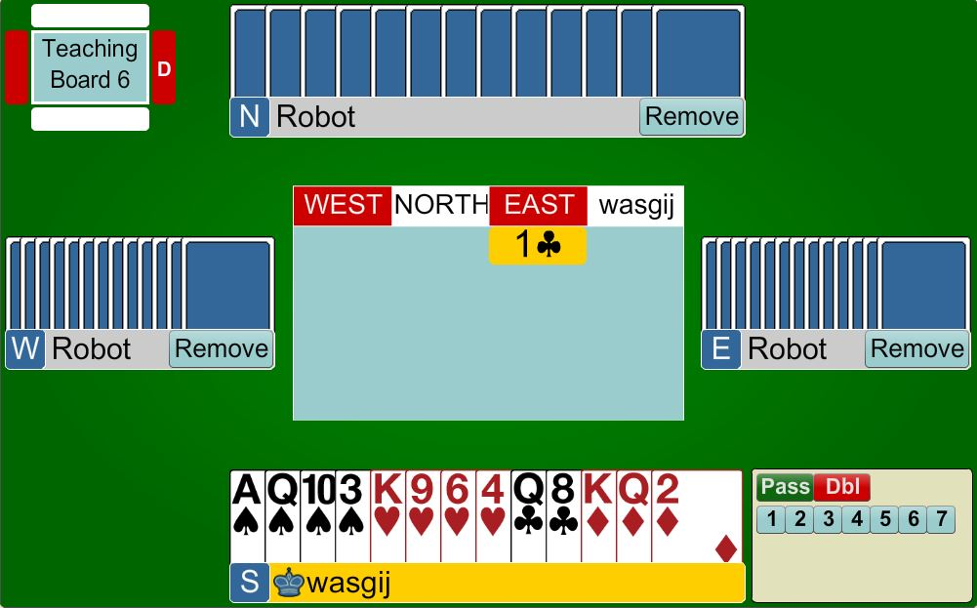
?
16 points, balanced hand BUT no Club hold … so cannot bid 1NT

Slide 18
Response to Overcall of 1NT
Unbalanced Hand
  Use same responses as for 1 NT opening bid … BUT adjust point counts
  0 – 7 points – bid your own suit
  8+ points – bid your 5-card suit (major) at 3-level or bid your 6-card suit at GAME

Slide 19
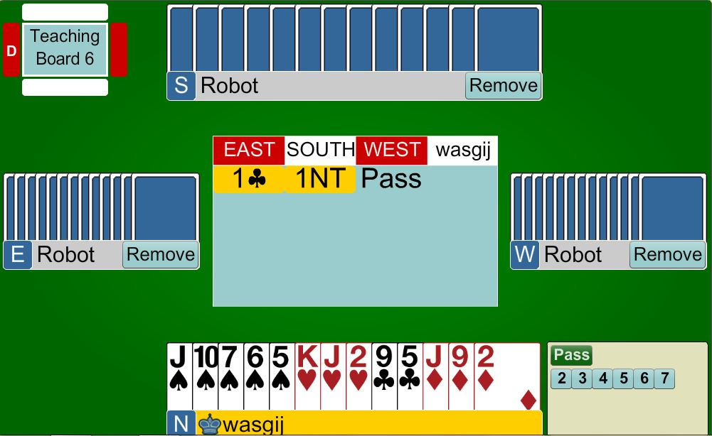
2♠
UNBALANCED HAND … not enough points for game, therefore, bid your long suit

Slide 20
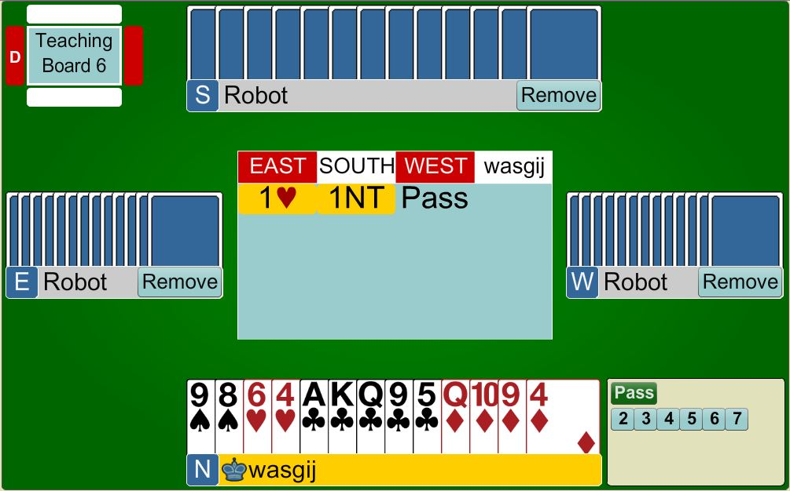
3♣
UNBALANCED HAND … with points for GAME … show your 5-card suit by bidding at the 3-level

Slide 21

Response to Overcall of 1NT
Balanced Hand
  0 – 7 points – PASS
  8 points – invite to game – 2NT
  9+ points – bid game – 3NT

Slide 22
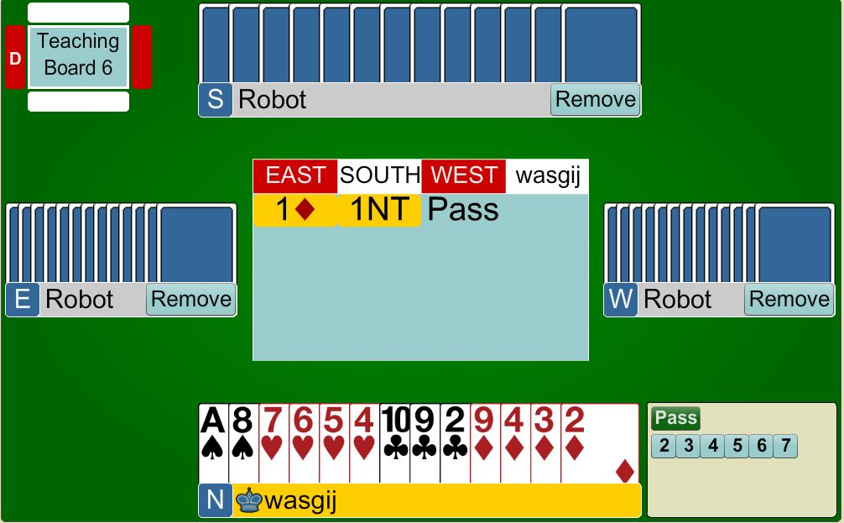
PASS
BALANCED HAND … not enough points for game, therefore, PASS

Slide 23

3NT
BALANCED HAND … points for game … so bid 3NT

Slide 24
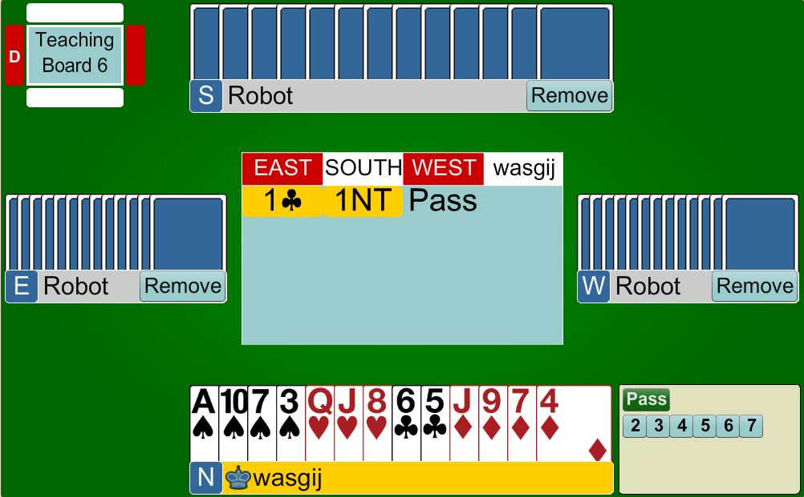
2NT
BALANCED HAND … with 8 points so CLOSE TO GAME … ask partner if they are 16 or 18 so they can bid accordingly

Slide 25

BEGINNERS’ LESSONS
Please contact me if you have any questions
Teacher: Your Name Here
Telephone: 123 4567
Email: email@address.co.nz

