Slide 1

BEGINNERS’ LESSONS
Welcome
Teacher: Your Name Here
Telephone: 123 4567
Email: email@address.co.nz

Slide 2
Lesson Eight
Takeout Doubles

Slide 3

Reasons for Overcalling
To get into the bidding … make it hard for the opposition
Express a genuine desire to play in a suit
Suggest a lead for partner

Slide 4

Rules to Overcall a suit
MUST be a 5+ card suit with a good suit – 2+ honours in suit
Point count should be close to opening values … a little
bit less is OK though

Slide 5
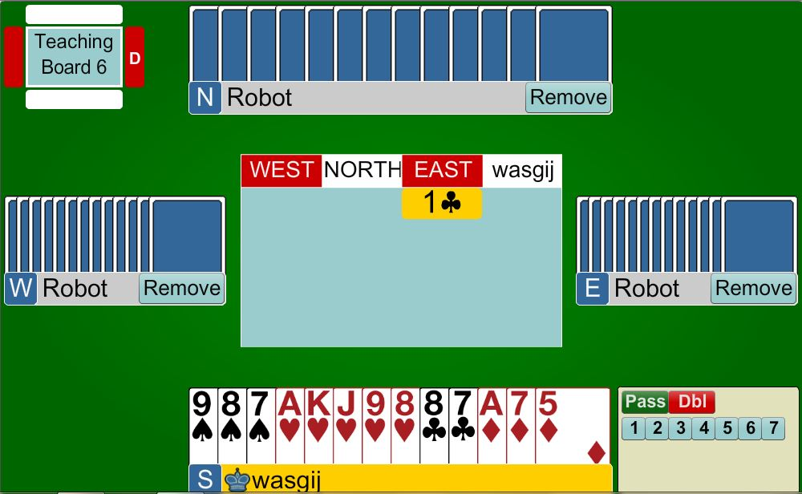
1♥
Opening Hand with GOOD 5-card suit (at least two honours in the suit)

Slide 6
Rules to Overcall in NoTrumps
Need BETTER points than an opening 1NT
  16 – 18 points
MUST have a cover in the
opposition’s suit

Slide 7
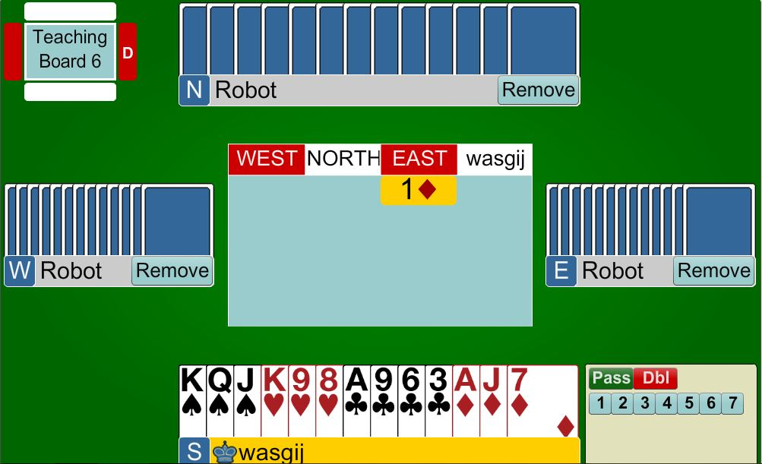

1NT
18 points, balanced hand with a diamond hold

Slide 8

WHAT HAPPENS when your hand doesn’t meet this criteria?
No 5-card suit
Can’t bid NT because you have no hold in the opposition’s suit
Can’t bid NT because your
hand is not strong enough

Slide 9
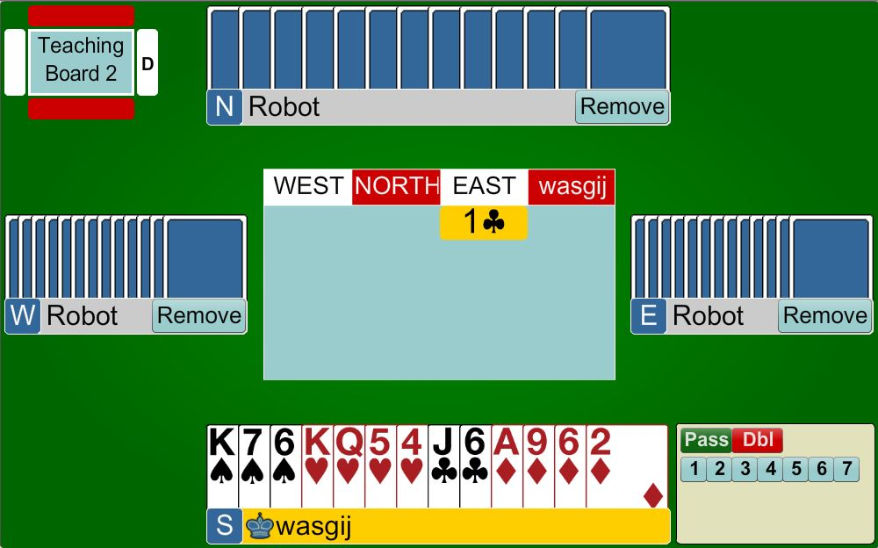
X
13 points, no 5-card suit
… can’t bid a suit
… can’t bid 1NT … not strong enough

Slide 10
Takeout Double shows the following:
At least 3 cards in each of the unbid suits
Shortage in the opponent’s suit
Opening hand (12+ points)
X asks partner to choose the best contract
Do not DOUBLE with length in opponent’s suit

Slide 11
Choices when Overcalling
FIRST CHOICE … Overcall a major
SECOND CHOICE … Overcall 1NT
THIRD CHOICE … Use the takeout X
FOURTH CHOICE… Overcall a minor
REMEMBER MAJORS ARE THE MOST IMPORTANT

Slide 12
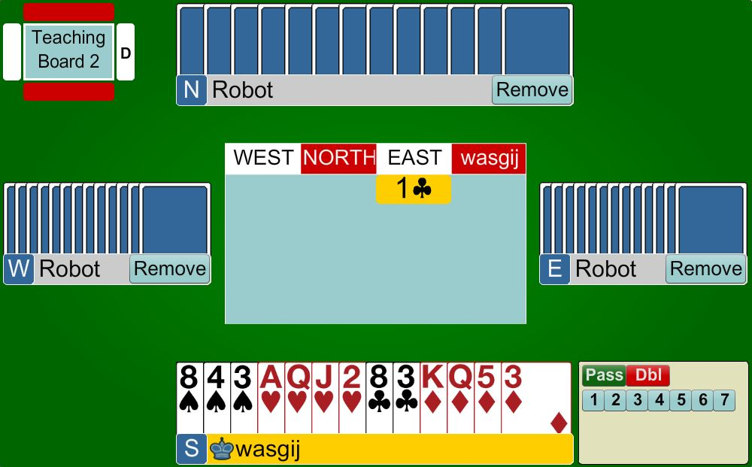
X
12+ points
3 cards in each of the unbid suits
Shortage in opposition suit

Slide 13
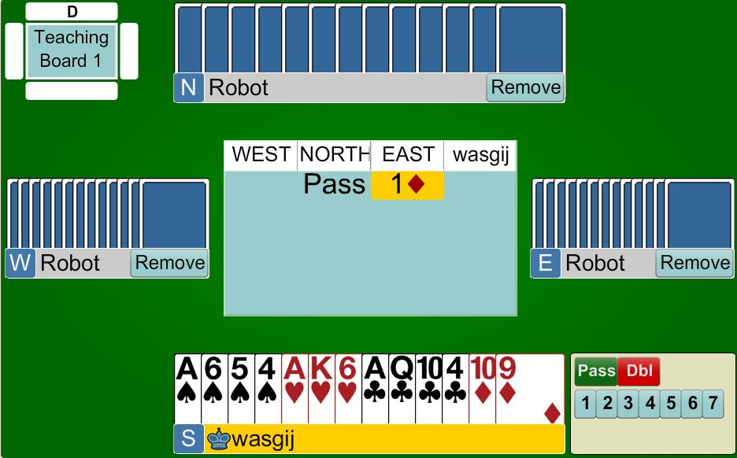

X
12+ points
3+ cards in each of the unbid suits
Shortage in opposition suit

Slide 14
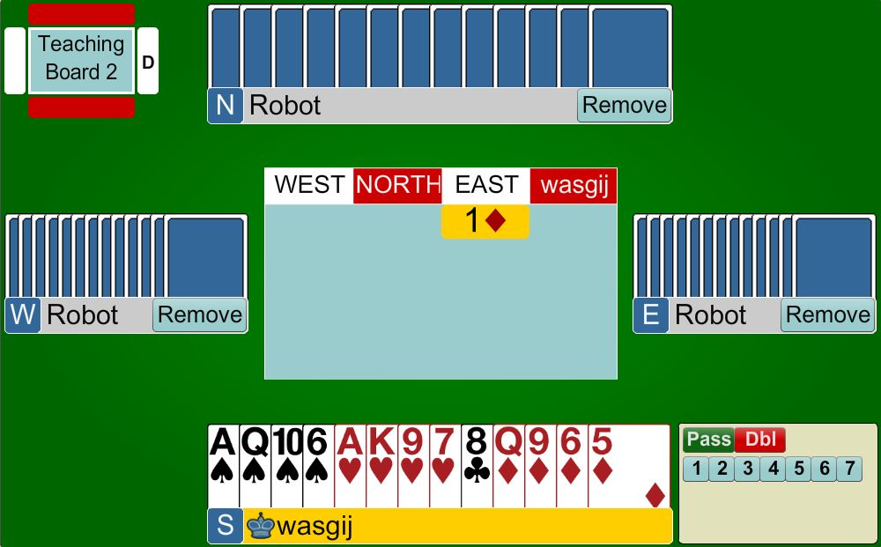
1♣
X
12+ points
3 cards in each of the unbid suits
Shortage in opposition suit

Slide 15
/
15 points … BUT only 1 club … Not balanced … therefore have to PASS

Slide 16
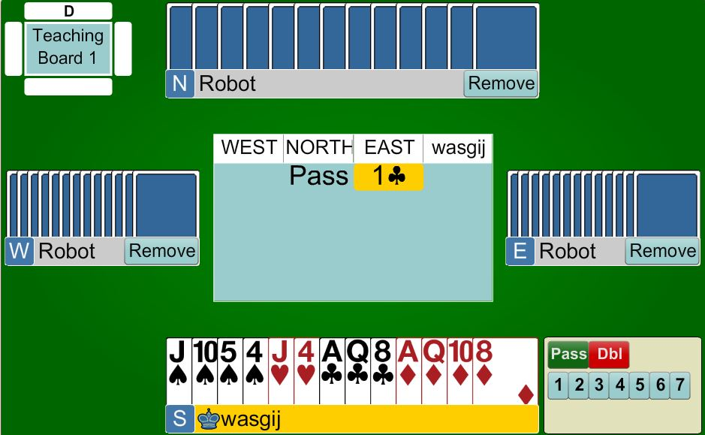
PASS
14 points … BUT only 2 hearts … balanced hand but cannot bid 1NT because there are not enough points … therefore have to PASS

Slide 17

Response to a Takeout Double
If your RHO passes … YOU HAVE TO BID
  … even if you have no points …
  … even at the 2-level if necessary
  REMEMBER partner has promised that he can handle any other suit
You do not have to bid after an opponent calls

Slide 18

Response to a Takeout Double
FIRST CHOICE
  Give preference to a major
SECOND CHOICE
  Bid 1NT
THIRD CHOICE
  Give preference to a minor
You do not have to bid after an opponent calls

Slide 19
Response to a Takeout Double
GAME | 13+ | Jump to GAME Suit (5+), or 3NT
INVITATIONAL | 10-12 | Jump in a suit (4+) Bid 2NT (with a stop)
MINIMUM | 0-9 | Bid your own suit (4+) Or 1NT with 6-9 points

Slide 20
Response to a Takeout Double
If the opponent’s bid BEFORE you are forced to bid, you can now PASS
Therefore a bid from you now
shows 8+ points … it is a CONSTRUCTIVE bid
You do not have to bid after an opponent calls

Slide 21
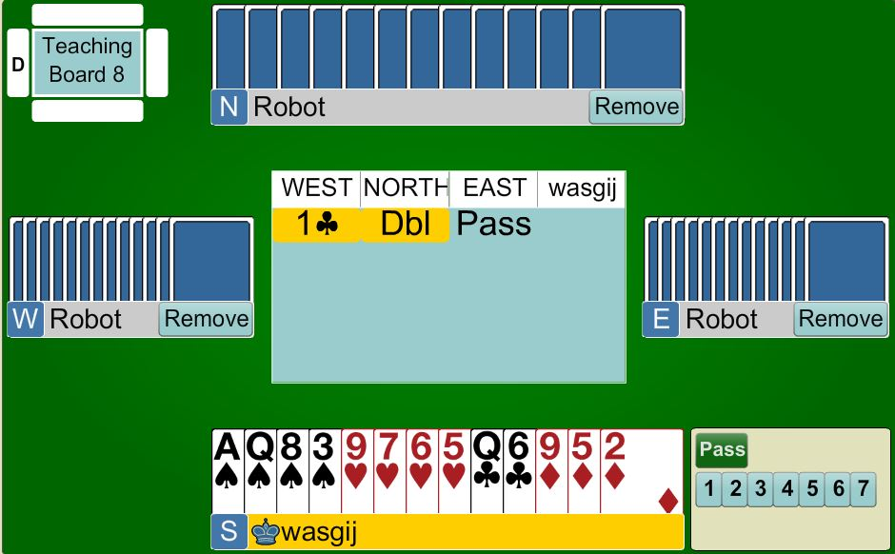
1♥
Bid your lowest 4 -card major
<10 points so bid at the lowest level possible

Slide 22
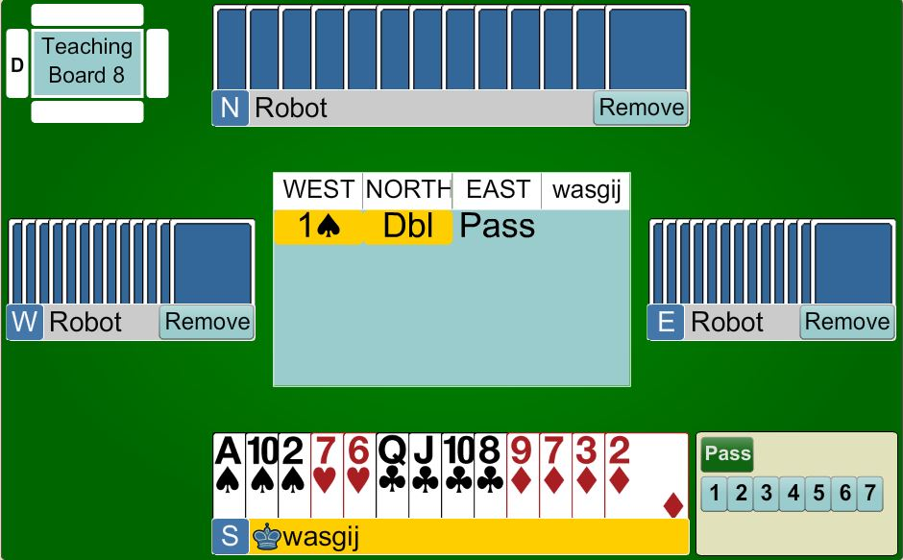
1NT
6 – 9 points, no 4-card major, balanced hand with a Spade hold
… therefore bid 1NT

Slide 23
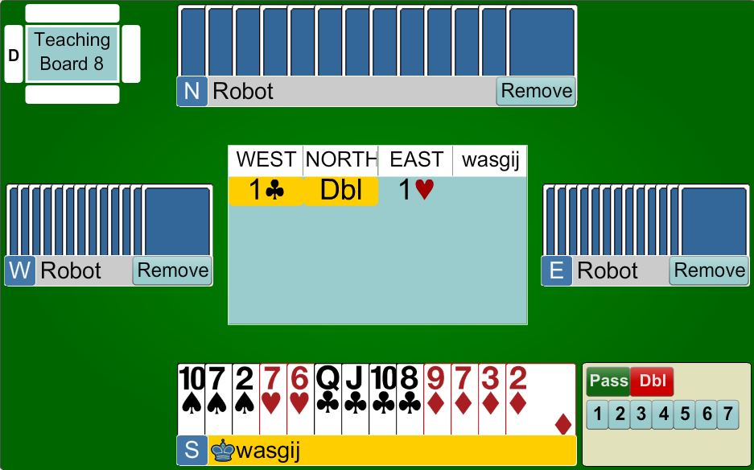
PASS
East has bid … you don’t have to bid now
<8 points, therefore PASS

Slide 24

1♥
Bid your major at the lowest level

Slide 25
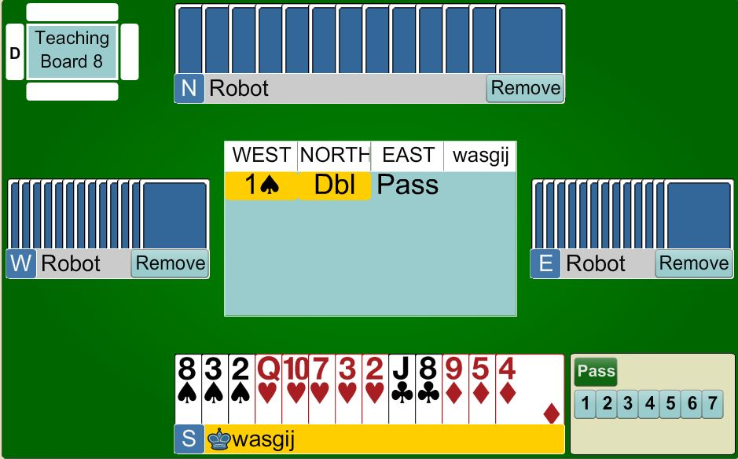
2♥
Bid your major at the lowest level

Slide 26
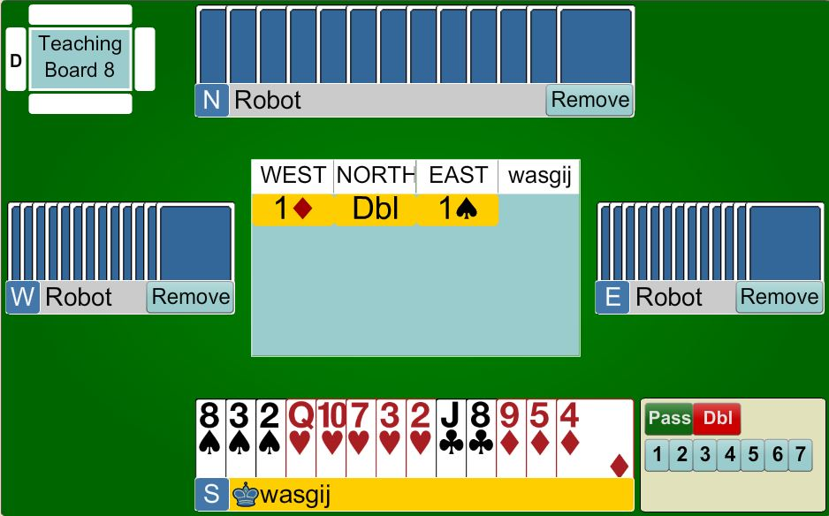
PASS
You don’t have to bid

Slide 27

BEGINNERS’ LESSONS
Please contact me if you have any questions
Teacher: Your Name Here
Telephone: 123 4567
Email: email@address.co.nz

