Slide 1

BEGINNERS’ LESSONS
Welcome
Teacher: Your Name Here
Telephone: 123 4567
Email: email@address.co.nz

Slide 2
Lesson Nine
Pre-emptive Openings

Slide 3

Rules up until NOW
1-suit openings – 12-19 points
1NT opening – 12-14 points
BUT sometimes we have less then 12 points but still have some desire to get into the bidding … when????
We have a LONG suit of our own –
i.e. 6 or more cards in the suit

Slide 4
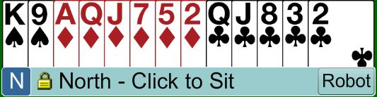
Pre-emptive Openings
Open 1♦
12 – 19 points
Open longest suit first

Slide 5
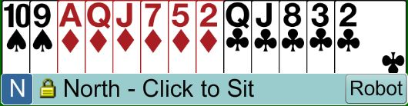

Pre-emptive Openings
BUT STILL a hand worth bidding on
12-19 points

Slide 6
NEW OPENING BIDS … 2-level
2♦ ⇒ 6 – 10 points with a GOOD 6-card diamond suit
2♥ ⇒ 6 – 10 points with a GOOD 6-card heart suit
2♠ ⇒ 6 – 10 points with a GOOD 6-card spade suit
A GOOD suit is a suit with 2+ honours in the suit
Once you have opened these bids your will rarely bid again … you have JUST one shot
These bids are DESTRUCTIVE … we want to make it hard for the opposition

Slide 7
NEW OPENING BIDS … 2-level
2♦ ⇒ 6 – 10 points with a GOOD 6-card diamond suit
2♥ ⇒ 6 – 10 points with a GOOD 6-card heart suit
2♠ ⇒ 6 – 10 points with a GOOD 6-card spade suit
NOTE THAT 2♣ is not used to show this type of hand
The 2♣ opener is a SPECIAL bid showing a STRONG hand
These bids are DESTRUCTIVE … we want to make it hard for the opposition

Slide 8

Pre-emptive Openings … 2-level
Open 2♠
6-10 points
GOOD 6-card suit

Slide 9

Pre-emptive Openings – 2-level
PASS
6-10 points
BAD 6-card suit

Slide 10
RESPONSES TO 2-level openers
PASS ⇒ 0 – 13 points, 0-3 card support
3-level raise ⇒ 14-15 points, 2+ card support
GAME ⇒ 16+ points, 2+ card support
GAME ⇒ 0+ points, 4+ card support
NEW SUIT ⇒ 17+ points, 6+ card suit of own
2-level opening bids are DESTRUCTIVE … we want to make it hard for the opposition … THEREFORE ONLY respond if you think there is a chance of reaching GAME OR you have a 10+ card fit

Slide 11
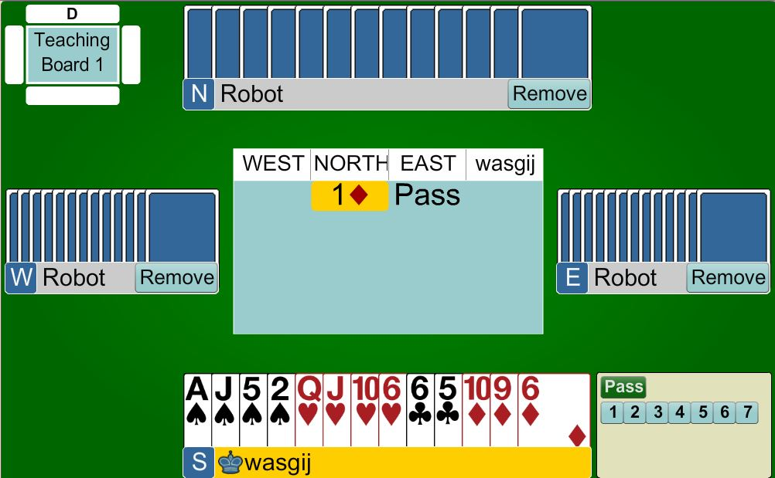
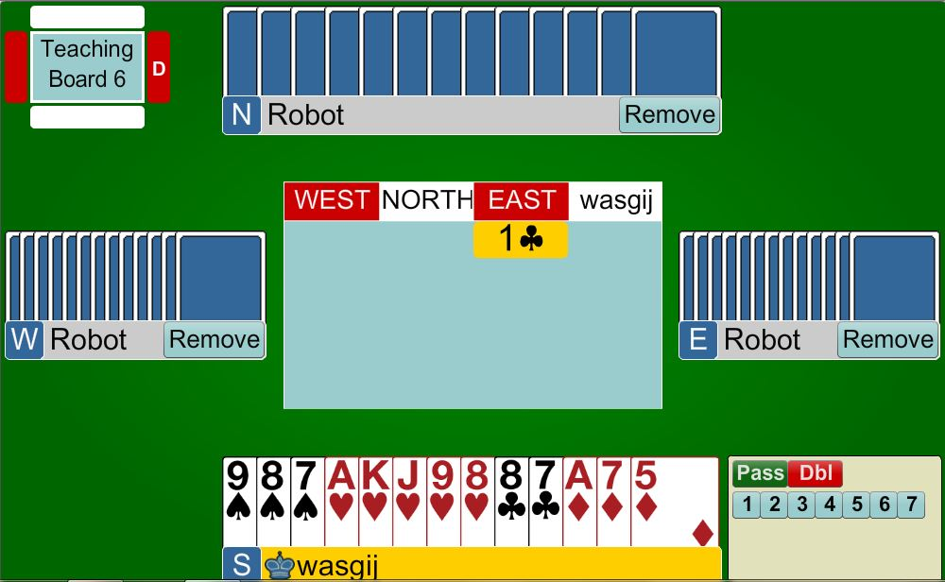
2♦
Pass
<14 points
West now has to guess what to do

Slide 12
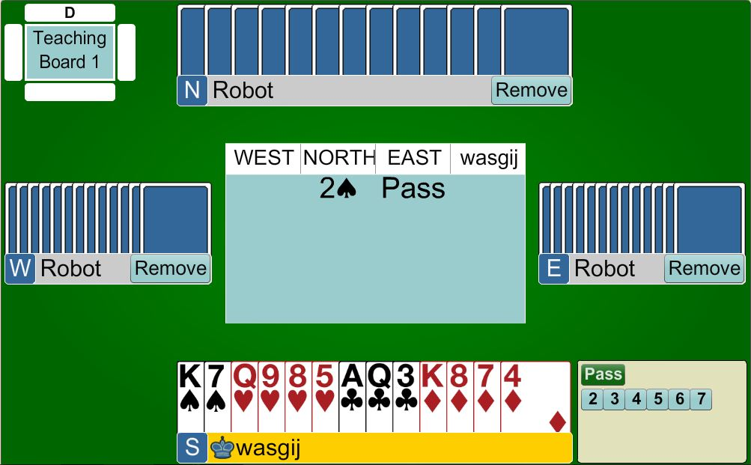
3♠
14-15 points
We have a FIT
Invite partner to GAME

Slide 13
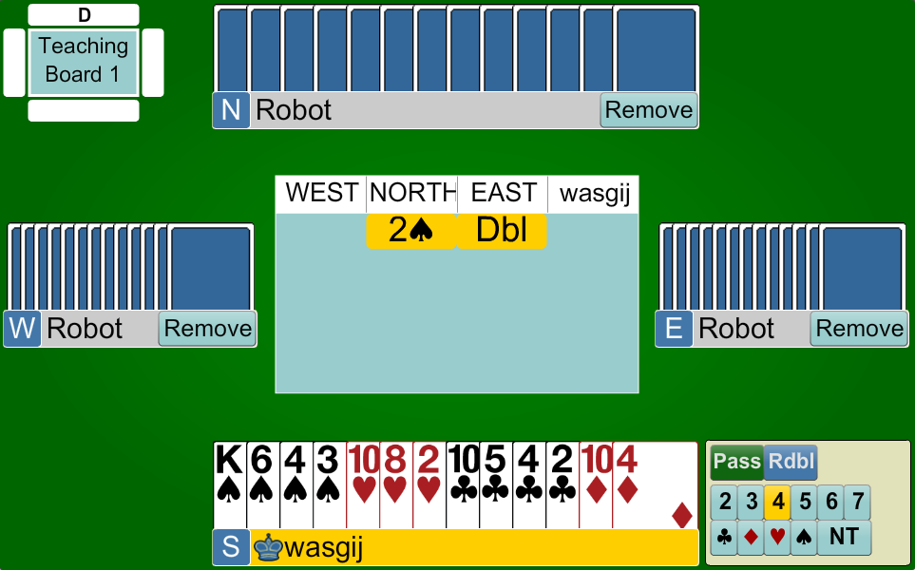
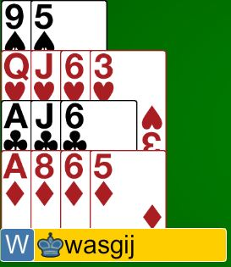

What does West do?
PASS?
5 Hearts?
Double?
They have to GUESS
4♠
Put West to the guess
We have a 10-card FIT
Bid to GAME
16 points
2-card support … WE HAVE A FIT
Bid to GAME

Slide 14
NEW OPENING BIDS … 3-level
3♣ ⇒ 6 – 10 points with a GOOD 7-card club suit
3♦ ⇒ 6 – 10 points with a GOOD 7-card diamond suit
3♥ ⇒ 6 – 10 points with a GOOD 7-card heart suit
3♠ ⇒ 6 – 10 points with a GOOD 7-card spade suit
A GOOD suit is a suit with 2+ honours in the suit
Once you have opened these bids your will rarely bid again … you have JUST one shot
These bids are DESTRUCTIVE … we want to make it hard for the opposition

Slide 15
RESPONSES TO 3-level openers
PASS ⇒ 0 – 13 points, 0-2 card support
GAME ⇒ 16+ points, 1+ card support
GAME ⇒ 0+ points, 3+ card support
NEW SUIT ⇒ 17+ points, 6+ card suit of own
3-level opening bids are DESTRUCTIVE … we want to make it hard for the opposition
THEREFORE ONLY respond if you think there is a chance of reaching GAME

Slide 16
NEW OPENING BIDS … 4-level
4♥ ⇒ 6 – 10 points with a GOOD 8-card heart suit
4♠ ⇒ 6 – 10 points with a GOOD 8-card spade suit
A GOOD suit is a suit with 2+ honours in the suit
These bids are DESTRUCTIVE … we want to make it hard for the opposition

Slide 17

WHAT DO YOU DO WHEN THE OPPOSITION MAKES THESE WEAK BIDS?
The same rules apply for X’s
The same rules apply for overcalls
The same rules apply for bidding NT’s
JUST be mindful that you might need slightly better point counts

Slide 18

BEGINNERS’ LESSONS
Please contact me if you have any questions
Teacher: Your Name Here
Telephone: 123 4567
Email: email@address.co.nz

