Slide 1

BEGINNERS’ LESSONS
Welcome
Teacher: Your Name Here
Telephone: 123 4567
Email: email@address.co.nz

Slide 2
Lesson Ten
Strong Opening Bids

Slide 3


Rules up until NOW
1-level openings – 12-19 points
1NT opening – 12-14 points
2-level openings – 6-10 points
3-level openings – 6-10 points
BUT sometimes we have 20+ points!!!

Slide 4
Balanced Hands
POINT COUNT | NOTRUMP STRUCTURE
12 – 14 | Open 1NT
15 – 17 | Bid a suit then rebid 1NT
18 – 19 | Bid a suit then rebid 2NT
20 – 22
23+

Slide 5
Balanced Hands
POINT COUNT | NOTRUMP STRUCTURE
12 – 14 | Open 1NT
15 – 17 | Bid a suit then rebid 1NT
18 – 19 | Bid a suit then rebid 2NT
20 – 22 | Open 2NT
23+

Slide 6
STRONG OPENING BIDS
2NT
20 – 22 points
Balanced Hand
There are TWO Strong Opening Bids

Slide 7

STRONG OPENING BIDS
Open 2NT
20 – 22 points
Balanced hand

Slide 8

STRONG OPENING BIDS
Open 2NT
20 – 22 points
Balanced hand

Slide 9
RESPONSES TO 2NT – 20-22 Pts
PASS ⇒ 0-4 points, no GAME
3♣/♦ ⇒ 5+ card suit … forcing
3♥/♠ ⇒ 5-card suit … forcing
3NT ⇒ No 5-card major, balanced hand
4♥/♠ ⇒ 6-card suit
Responses to 2NT openers are similar to 1NT openers … BUT there is no weak option now

Slide 10
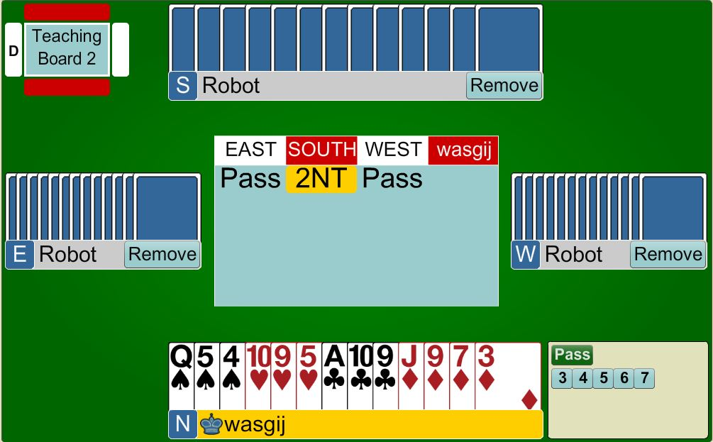


3NT
5+ points
Balanced hand

Slide 11

3♥
5+ points
5-card heart suit

Slide 12
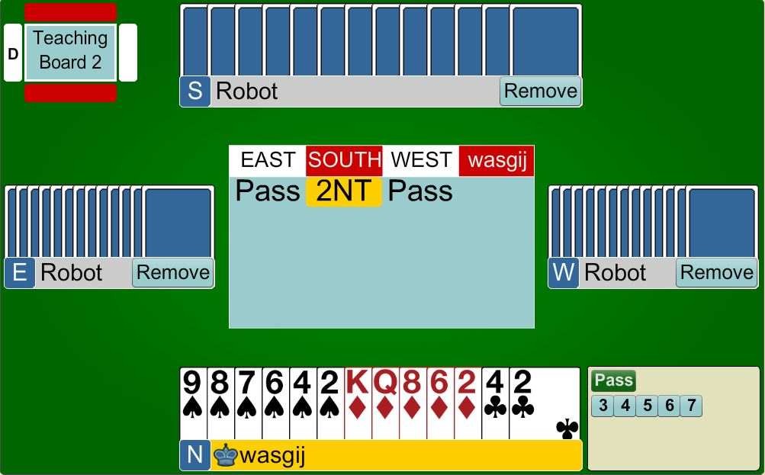
4♠
5+ points
6-card spade suit

Slide 13
STRONG OPENING BIDS
2♣
20+ points (Distributional hand)
or
23+ points (Balanced Hand)
2♣ is an ARTIFICIAL BID
Partner HAS to keep bidding until GAME is reached

Slide 14
Balanced Hands
POINT COUNT | NOTRUMP STRUCTURE
12 – 14 | Open 1NT
15 – 17 | Bid a suit then rebid 1NT
18 – 19 | Bid a suit then rebid 2NT
20 – 22 | Open 2NT
23+ | Open 2♣ then rebid 2NT or 3NT

Slide 15
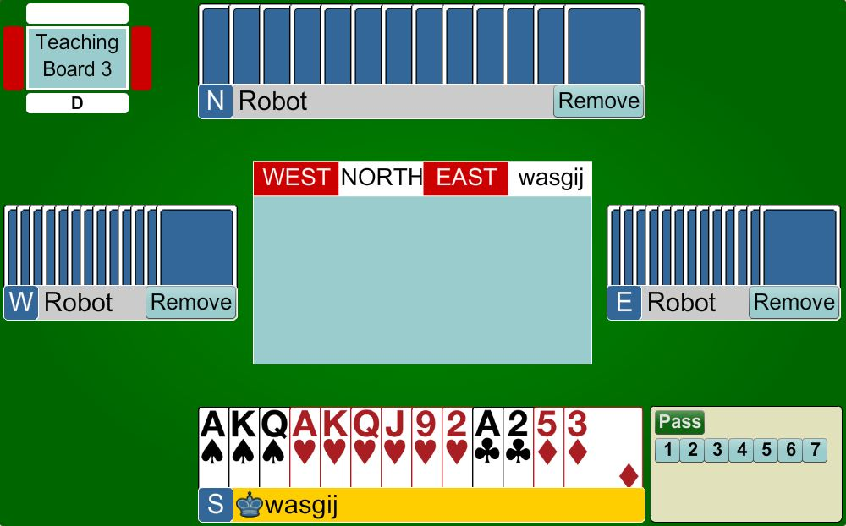
STRONG OPENING BIDS
Open 2♣
20+ points
Distributional hand
2♣ is an ARTIFICIAL BID
Partner HAS to keep bidding until GAME is reached

Slide 16
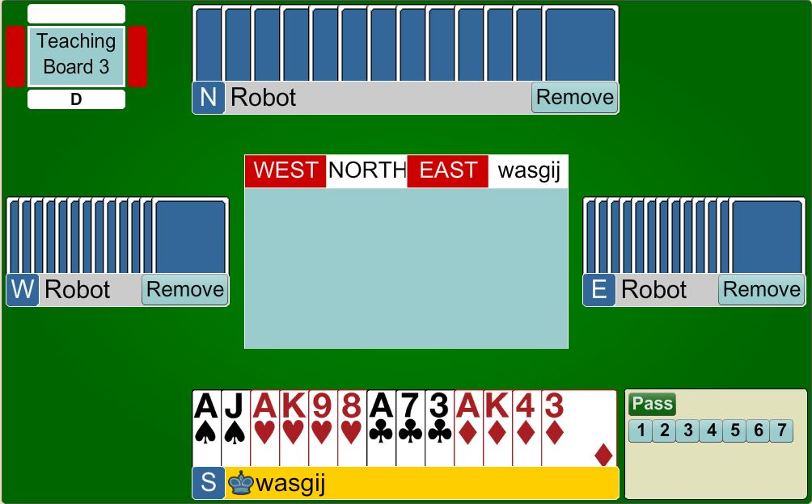
STRONG OPENING BIDS
Open 2♣
23+ points
Balanced hand
2♣ is an ARTIFICIAL BID
Partner HAS to keep bidding until GAME is reached

Slide 17
RESPONSES TO 2♣
2♦ ⇒ 0-7points, any shape
2♥/♠ ⇒ 8+ points, 5+ card suit
2NT ⇒ 8+ points, balanced hand
3♣/♦ ⇒ 8+ points, 5+ card suit
The 2♦response is artificial … it has NOTHING to do with diamonds

Slide 18
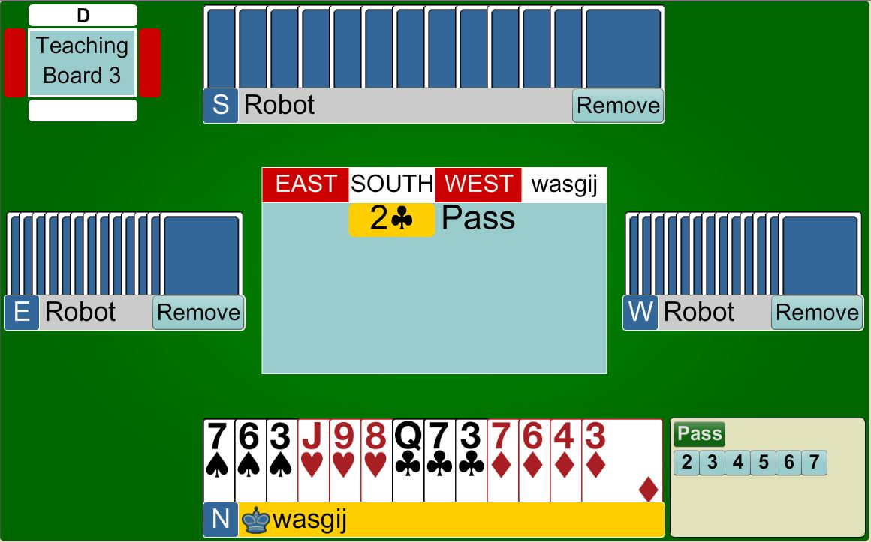
2♦
0 – 7 points
Bid 2♦ ... This is an ARTIFICIAL BID

Slide 19
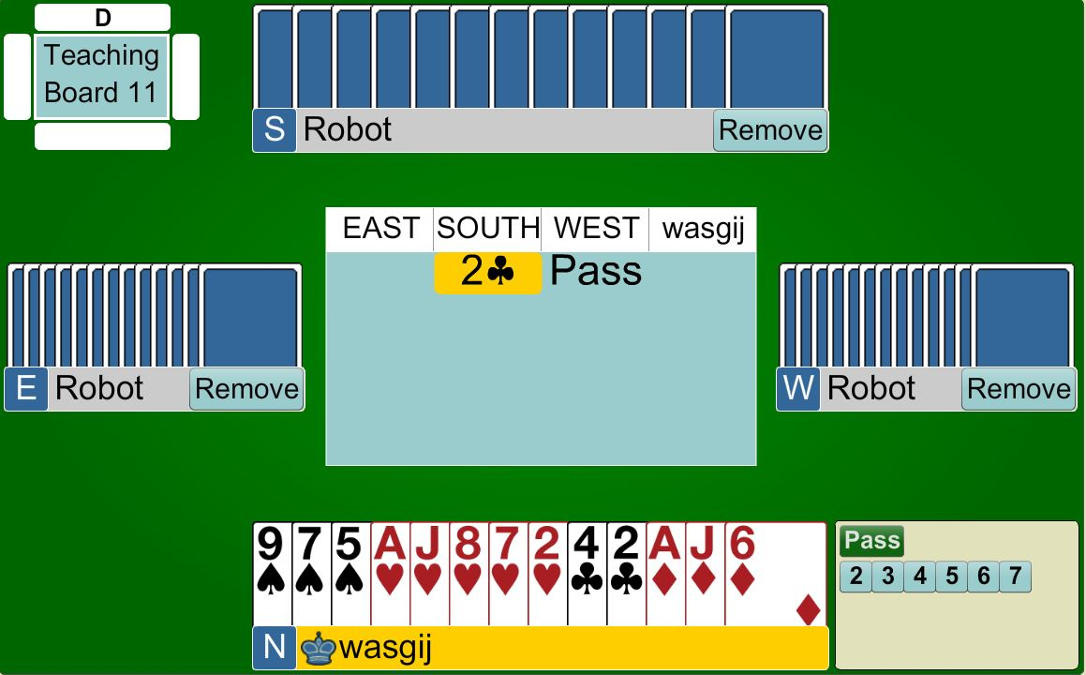
2♥
8+ points
Bid 2♥ ... Shows 5+ hearts

Slide 20

2NT
8+ points
No 5-card suit ... Bid 2NT

Slide 21

OPENER’S REBIDS AFTER 2♣
IF partner bids 2♦
  Bid your own 5-card suit
  Bid 2NT (shows 23 or 24 points)
  Bid 3NT (shows 25+ points)
REMEMBER ... Partner HAS to keep bidding until GAME is reached

Slide 22
OPENER’S REBIDS AFTER 2♣
IF partner bids 2♥/2♠
  Agree the FIT with 3 of the suit
  Bid 2NT (23 + points) – no fit
  Bid your own suit with 5-card suit
REMEMBER ... Partner HAS to keep bidding until GAME is reached

Slide 23
OPENER’S REBIDS AFTER 2♣
IF partner bids 2NT
  Bid 3♥/3♠ with 5-card suit
  Bid 4♥/4♠ with 6+ card suit
  Bid 3NT with balanced hand
  Only bid a MINOR if desperate!!!
REMEMBER ... Partner HAS to keep bidding until GAME is reached

Slide 24
OPENER’S REBIDS AFTER 2♣
IF partner bids 3♣/ 3♦
  Bid your own MAJOR suit with 5+ in suit
  Bid 3NT with balanced hand
  Raise minor only if desperate!!!!
REMEMBER ... Partner HAS to keep bidding until GAME is reached

Slide 25
STRONG OPENING BIDS
Open 2♣
Partner bids 2♦
Now bid 2♥ ... Showing 5+ hearts ...
2♣ is an ARTIFICIAL BID
Partner HAS to keep bidding until GAME is reached

Slide 26
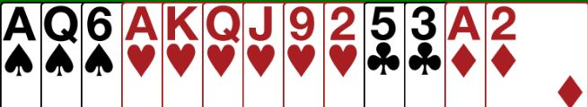
STRONG OPENING BIDS
Open 2♣
Partner bids 2NT
Now bid 4♥ ... Showing 6+ hearts ...
Partner MUST have 2+ hearts.
2♣ is an ARTIFICIAL BID
Partner HAS to keep bidding until GAME is reached

Slide 27
STRONG OPENING BIDS
Open 2♣
Partner bids 2NT
Now bid 3NT ... No 5-card major to bid
2♣ is an ARTIFICIAL BID
Partner HAS to keep bidding until GAME is reached

Slide 28
STRONG OPENING BIDS
Open 2♣
Partner bids 2♥
Now bid 3♥ ... Show partner you have a fit
2♣ is an ARTIFICIAL BID
Partner HAS to keep bidding until GAME is reached

Slide 29

BIDDING TO SLAM
A SLAM needs tricks
IF the partnership has 32+ points you MAY have the values for SLAM.
You NEED to check that you are not missing TWO aces

Slide 30


ASKING FOR ACES USING 4NT
5♣ ⇒ No Aces
5♦ ⇒ 1 Ace
5♥ ⇒ 2 Aces
5♠ ⇒ 3 Aces
Count on your fingers ... Start from ZERO

Slide 31

BEGINNERS’ LESSONS
Please contact me if you have any questions
Teacher: Your Name Here
Telephone: 123 4567
Email: email@address.co.nz

