Slide 1

IMPROVERS’ LESSONS
Welcome
Teacher: Your Name Here
Telephone: 123 4567
Email: email@address.co.nz

Slide 2
Lesson Two
Blackwood

Slide 3
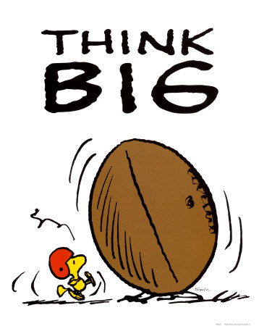
When should you look for Slam?
1. When you have 32+HCP and no fit
2. When you have 30+HCP and a fit
3. With a VERY good fit and extra distribution (and close to 30HCP)

Slide 4
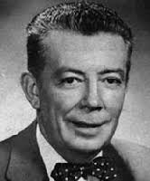
Blackwood Convention
Invented by Easley Blackwood
Mr Blackwood was American
He died aged 89 in 1992
Inducted into the ACBL Hall
of Fame in 1995 (a bit late!)

Slide 5
Blackwood Convention
Allows the one player to find the number of Aces and Kings held by their partner
It is important to be sure which suit is trumps (or NoTrumps)

Slide 6
Why use Blackwood?
To prevent bidding a small slam missing two or more Aces
To prevent bidding a grand slam missing an Ace
To find MISSING Aces

Slide 7

4NT – Asks for Aces
4NT asks partner … “How
many Aces do you have?”
Partner must answer the question
4NT is an ARTIFICIAL bid

Slide 8
Responses to 4NT
5♣ = 0 or 4 aces
5♦ = 1 ace
5♥ = 2 aces
5♠ = 3 aces
4NT is an ARTIFICIAL bid

Slide 9
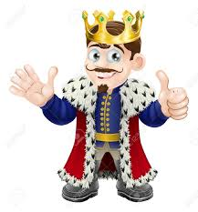
5NT – Asks for Kings
5NT asks partner … “How
many Kings do you have?”
Partner must answer the question
You must have all the Aces
5NT is an ARTIFICIAL bid

Slide 10
Responses to 5NT
6♣ = 0 or 4 kings
6♦ = 1 king
6♥ = 2 kings
6♠ = 3 kings
5NT is an ARTIFICIAL bid

Slide 11

Should we bid SMALL or GRAND slam?
PARTNER | YOU
1♥

Slide 12
Should we bid SMALL or GRAND slam?
PARTNER | YOU
1♥ | 1♠

Slide 13
Should we bid SMALL or GRAND slam?
PARTNER | YOU
1♥ | 1♠
3♦

Slide 14
Should we bid SMALL or GRAND slam?
PARTNER | YOU
1♥ | 1♠
3♦ | 4NT

Slide 15
Should we bid SMALL or GRAND slam?
PARTNER | YOU
1♥ | 1♠
3♦ | 4NT
5♦

Slide 16
Should we bid SMALL or GRAND slam?
PARTNER | YOU
1♥ | 1♠
3♦ | 4NT
5♦ | 6♠

Slide 17

Should we bid SMALL or GRAND slam?
PARTNER | YOU
1♠

Slide 18
Should we bid SMALL or GRAND slam?
PARTNER | YOU
1♠ | 2♥

Slide 19
Should we bid SMALL or GRAND slam?
PARTNER | YOU
1♠ | 2♥
3♥

Slide 20
Should we bid SMALL or GRAND slam?
PARTNER | YOU
1♠ | 2♥
3♥ | 4NT

Slide 21
Should we bid SMALL or GRAND slam?
PARTNER | YOU
1♠ | 2♥
3♥ | 4NT
5♦

Slide 22
Should we bid SMALL or GRAND slam?
PARTNER | YOU
1♠ | 2♥
3♥ | 4NT
5♦ | 5♥

Slide 23

Should we bid SMALL or GRAND slam?
PARTNER | YOU
1♣

Slide 24
Should we bid SMALL or GRAND slam?
PARTNER | YOU
1♣ | 1♦

Slide 25
Should we bid SMALL or GRAND slam?
PARTNER | YOU
1♣ | 1♦
1♥

Slide 26
Should we bid SMALL or GRAND slam?
PARTNER | YOU
1♣ | 1♦
1♥ | 4NT

Slide 27
Should we bid SMALL or GRAND slam?
PARTNER | YOU
1♣ | 1♦
1♥ | 4NT
5♠

Slide 28
Should we bid SMALL or GRAND slam?
PARTNER | YOU
1♣ | 1♦
1♥ | 4NT
5♠ | 5NT

Slide 29
Should we bid SMALL or GRAND slam?
PARTNER | YOU
1♣ | 1♦
1♥ | 4NT
5♠ | 5NT
6♣

Slide 30
Should we bid SMALL or GRAND slam?
PARTNER | YOU
1♣ | 1♦
1♥ | 4NT
5♠ | 5NT
6♣ | 6♥

Slide 31

IMPROVERS’ LESSONS
Please contact me if you have any questions
Teacher: Your Name Here
Telephone: 123 4567
Email: email@address.co.nz

