Slide 1

IMPROVERS’ LESSONS
Welcome
Teacher: Your Name Here
Telephone: 123 4567
Email: email@address.co.nz

Slide 2
Lesson Six
Opening Leads

Slide 3
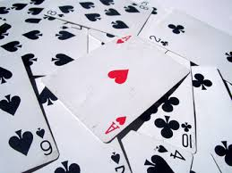
TWO TYPES OF CONTRACT
Notrump Contracts
OR
Suit Contracts

Slide 4
Leads against a Notrump Contract
DO
Lead partner’s suit (if they have bid one)
Lead your longest suit
Lead an unbid suit (major before minor)

Slide 5



WHICH CARD AGAINST NT?
Lead TOP of a sequence of 3 honours
or broken sequence

Slide 6



WHICH CARD AGAINST NT?
Lead a LOW card – a low card promises an honour

Slide 7



WHICH CARD AGAINST NT?
Lead TOP of small cards – a high card denies an HONOUR

Slide 8




WHICH CARD AGAINST NT?
Lead TOP of an interior sequence of two or more honours

Slide 9
Leads against a Suit Contract
DO
Lead partner’s suit (if they have bid one)
Lead TOP of a sequence of 2 or more honours
Lead a singleton or top of a doubleton
Lead low from your longest or strongest suit
Lead an unbid suit

Slide 10
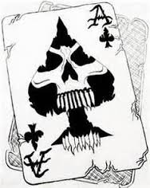
Leads against a Suit Contract
DO NOT
Lead a low card from a suit headed by the ace

Slide 11


WHICH CARD AGAINST A SUIT?
Lead TOP of a sequence of 2 or more honours

Slide 12


WHICH CARD AGAINST A SUIT?
Lead a LOW card – a low card promises an honour

Slide 13


WHICH CARD AGAINST A SUIT?
Lead top from small cards – a HIGH card denies an honour

Slide 14


WHICH CARD AGAINST A SUIT?
Lead TOP of an interior sequence of two more honours

Slide 15
GENERAL PRINCIPLES
If there is an unbid suit and you do not have an obvious lead, lead that suit
If you lead a LOW card, you promise an honour in that suit
If you lead a high card, you deny an honour in that suit
These principles apply throughout the defence

Slide 16
GENERAL PRINCIPLES
If you lead an honour card, it should at least have the honour below
Don’t lead away from an ace in a suit contract – you may lose to a singleton king
These principles apply throughout the defence

Slide 17
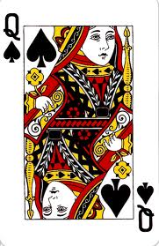
What would this lead by partner mean?
Top of a sequence
Partner has the jack (and hopefully the 10 as well)
Partner does NOT have the king

Slide 18
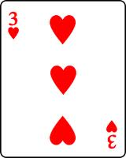
What would this lead by partner mean?
Low from an honour
Partner has a king, queen or jack of hearts
Partner has at least 3 hearts
NOTE: If defending against Notrumps, partner may also have the ace of the suit led
If leading against a suit contract … partner MAY have a singleton heart

Slide 19
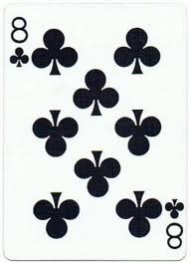
What would this lead by partner mean?
Top of rubbish
Partner has no honour cards in clubs
If leading against a suit contract … partner MAY have a singleton club

Slide 20

IMPROVERS’ LESSONS
Please contact me if you have any questions
Teacher: Your Name Here
Telephone: 123 4567
Email: email@address.co.nz

