Slide 1

IMPROVERS’ LESSONS
Welcome
Teacher: Your Name Here
Telephone: 123 4567
Email: email@address.co.nz

Slide 2
Lesson One
Stayman Convention

Slide 3

Basic Rules for Opening 1NT
12 - 14 HCP
Balanced Hand
  No singleton or void
  Only one doubleton
  No 5-card major
This bid is your FIRST choice of opening bid

Slide 4
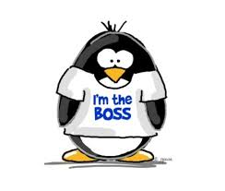
CURRENT Responses to 1NT
WITH A BALANCED HAND
  0 – 10 HCP … no GAME possible … PASS
  11 – 12 HCP … GAME is possible … Bid 2NT
  13+ HCP … definitely in GAME … Bid 3NT
These are going to change

Slide 5
CURRENT Responses to 1NT
WITH AN UNBALANCED HAND
  0 – 10 HCP … no GAME possible … Bid your longest suit at the lowest possible level
  13+ HCP ... Bid your 5-card suit at the 3-level
  13+ HCP … Bid your 6-card major at the 4-level
SOME of these are going to change

Slide 6
WHAT IS WRONG WITH THIS?
It is better to play in a major than it is to play in Notrumps
It is difficult to make an invitational bid
We can’t ever find a 4 / 4 fit in a major
Therefore, we use the Stayman Convention

Slide 7
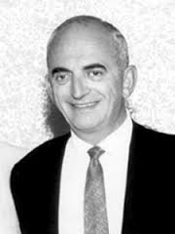
WHO INVENTED STAYMAN?
Sam Stayman got all the credit because he wrote about it first
It was actually invented by Sam’s
partner George Rapee
Jack Marx also came up with
the concept the same time as George

Slide 8
WHY USE STAYMAN?
To find a 4 – 4 fit in a major
To allow opener to pick their best major when partner has a weak hand, with both majors
The Stayman convention is a bid of 2♣ in response to a 1NT opener

Slide 9
WHEN TO USE STAYMAN?
You hold at least one 4-card major with 11+ HCP
You hold 5-4 in the majors with any HCP count ... The fewer HCP you have, the more important it is to use stayman.
The Stayman convention is a bid of 2♣ in response to a 1NT opener

Slide 10
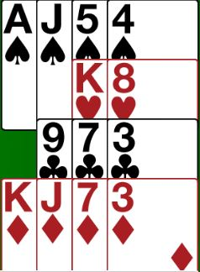
EXAMPLES ... Stayman or Not?
Partner opens 1NT
Your bid?
2♣
Enough HCP for game ...
Check for a 4-4 spade fit first

Slide 11
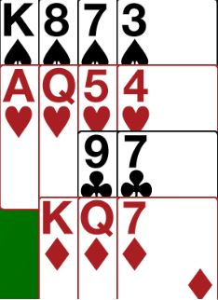
EXAMPLES ... Stayman or Not?
Partner opens 1NT
Your bid?
2♣
Enough HCP for game ...
Check for a 4-4 heart or spade fit first

Slide 12
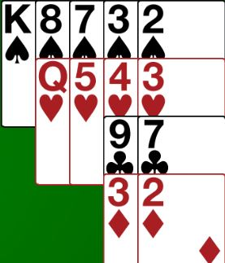
EXAMPLES ... Stayman or Not?
Partner opens 1NT
Your bid?
2♣
A weak hand with both majors
Gives us a chance to find the best place to play

Slide 13
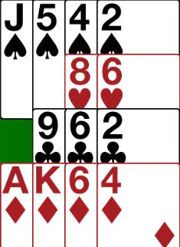
EXAMPLES ... Stayman or Not?
Partner opens 1NT
Your bid?
PASS
Even though you have a 4-card major, your hand is too weak

Slide 14
HOW TO RESPOND TO STAYMAN
1NT – 2♣ - ?
2♦- I don’t have a 4-card major
2♥- I have 4 hearts (I might have 4 spades)
2♠ - I have 4 spades (I don’t have 4 hearts)
2♣ says ... “Have you got a 4-card major?”
Opener MUST answer the question

Slide 15
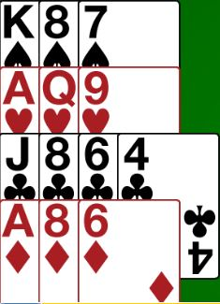
EXAMPLES ... Responding to Stayman
1NT
2♣
2♦
No 4-card major

Slide 16
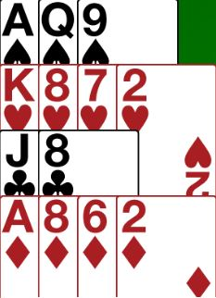
EXAMPLES ... Responding to Stayman
1NT
2♣
2♥
4-card heart suit

Slide 17
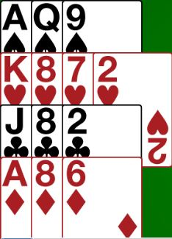
EXAMPLES ... Responding to Stayman
1NT
2♣
2♥
4-card heart suit

Slide 18
WHAT HAPPENS NEXT?
1NT – 2♣ - 2♦/2♥/2♠ - ?
Bid straight to game with a fit and game HCP
Bid straight to 3NT with no fit in the major and game HCP
Invite in a major (with a fit)
Invite in 2NT (with no fit)
Pass (with a weak hand and a fit)
Correct to 2♠with a weak hand and 5 spades

Slide 19
EXAMPLES ... Full bidding (1)
1NT
2♣
2♦
2NT
3NT

Slide 20
EXAMPLES ... Full bidding (2)
1NT
2♣
2♥
4♥

Slide 21
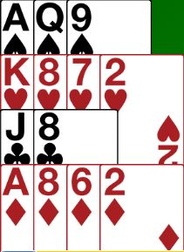
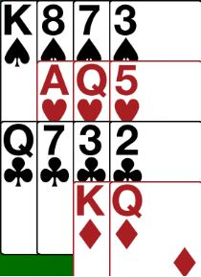
EXAMPLES ... Full bidding (3)
1NT
2♣
2♥
3NT
Note … East must have 4 spades

Slide 22
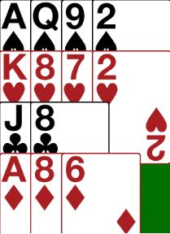
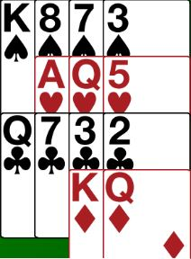
EXAMPLES ... Full bidding (4)
1NT
2♣
2♥
3NT
4♠
Convert to spades

Slide 23

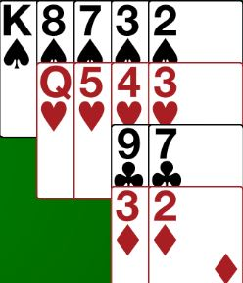
EXAMPLES ... Full bidding (5)
1NT
2♣
2♥
PASS
Happy to play in hearts

Slide 24
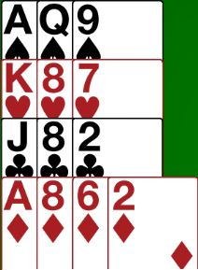
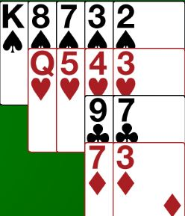
EXAMPLES ... Full bidding (6)
1NT
2♣
2♦
2♠
Pass
This is a weak bid

Slide 25

STAYMAN CAN ALSO BE USED FOR STRONG HANDS
Use after a 1NT overcall
  Invitational hands are now 8+ HCP
Use over 2NT openings
  No invitational option

Slide 26
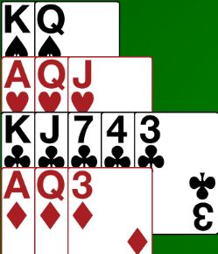
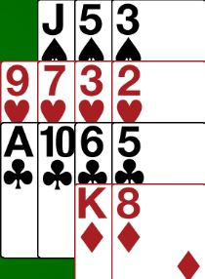
EXAMPLES ... Full bidding (7)
2NT
3♣
3♦
3NT
Notes:
3C stayman must be alerted in this situation

Slide 27
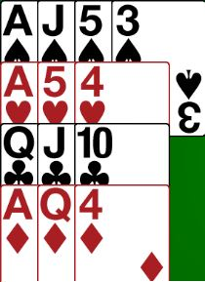
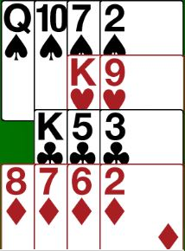
EXAMPLES ... Full bidding (8)
… after a 1♦ opening
1NT (overcall)
2♣
2♠
3♠
4♠
Maximum, bid game
Notes:
2C stayman must be alerted in this situation

Slide 28

IMPROVERS’ LESSONS
Please contact me if you have any questions
Teacher: Your Name Here
Telephone: 123 4567
Email: email@address.co.nz

