Slide 1

BEGINNERS’ LESSONS
Welcome
Teacher: Your Name Here
Telephone: 123 4567
Email: email@address.co.nz
Notes:
Updated slightly by Karen M 27th March, 2017 – Slide 6 had 9 repeated in the 2nd hand

Slide 2
Tip
The Finesse

Slide 3
PLAY OF THE HAND – THE FINESSE
The FINESSE is an attempt to gain a trick with a card that would normally be beaten by a higher card.
Generally you should play a low card TOWARDS honour cards hoping that the second player has the missing honour card.

Slide 4
PLAY OF THE HAND – THE FINESSE
Dummy | A Q 3
You | 9 7 4
How can we make 2 tricks in this suit?
Play a low card TOWARDS the Queen if 2nd player does not play the King
Hope that the 2nd player has the missing KING

Slide 5
PLAY OF THE HAND – THE FINESSE
Dummy | A 9 8
You | Q J 10
How can we make 2 tricks in this suit?
Play the Queen. If 2nd player does not play the King, play a low card
Hope that the 2nd player has the missing KING

Slide 6
PLAY OF THE HAND – THE FINESSE
Dummy | K 9 8
You | 7 6 4
How can we make 1 trick in this suit?
Play a low card TOWARDS the King if 2nd player does not play the Ace
Hope that the 2nd player has the missing ACE

Slide 7
PLAY OF THE HAND – THE FINESSE
Dummy | K Q 8
You | 4 3 2
How can we make 2 tricks in this suit?
Play a low card TOWARDS the King if 2nd player does not play the Ace … then repeat playing TOWARDS the Queen
Hope that the 2nd player has the missing ACE

Slide 8
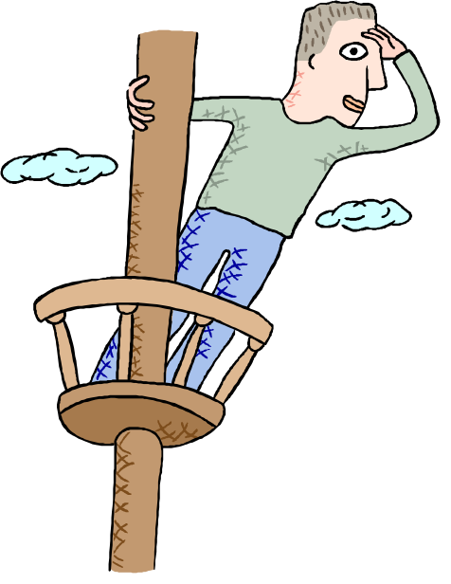

PLAY OF THE HAND – THE FINESSE
As a GENERAL rule
When you have missing honours, keep an eye out for an opportunity to FINESSE hoping that the second player has the missing honours

Slide 9

BEGINNERS’ LESSONS
Please contact me if you have any questions
Teacher: Your Name Here
Telephone: 123 4567
Email: email@address.co.nz

