Slide 1

INTERMEDIATE LESSONS
Welcome
Teacher: Your Name Here
Telephone: 123 4567
Email: email@address.co.nz

Slide 2

Checkback Stayman

Slide 3
Checkback Stayman
Checkback Stayman looks for a major fit, like normal Stayman, but is used later in an auction

Slide 4
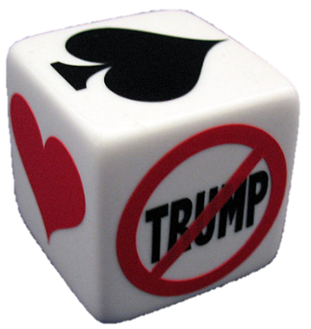
Checkback Stayman
It's main purpose is to firstly discover the Opener’s point count, then look for the majors

Slide 5
Checkback Stayman
… and allows the Opener to bypass a major to show their points first

Slide 6
Checkback Stayman
… and allows the Opener to bypass a major to show their points first

Slide 7
Checkback Stayman
Example
You Open 1♣ with this hand
♠AKT4 ♥AJ2 ♦K9 ♣J832
Partner responds with 1♥

Slide 8
Checkback Stayman
♠AKT4 ♥AJ2 ♦K9 ♣J832
After 1♣ - 1♥
you do not bid 1♠
Instead bid 1NT
to show the points

Slide 9
Checkback Stayman
Using Checkback also allows you to better define a weaker hand
1♣ - 1♥
1♠
Opener must now be a weaker hand
with too much shape to
open 1NT or rebid NT

Slide 10
Checkback Stayman
1♦ - 1♥
1♠
Below is an example of a weaker hand
that fits this bidding
♠AKT2 ♥9 ♦AT875 ♣K62

Slide 11
Checkback Stayman
After 1 or 2 NT rebid by Opener
What does Responder do if they do not have enough for game ?
PASS
or show a weak 2-suiter hand
more on that later

Slide 12
Checkback Stayman
After 1 or 2 NT rebid by Opener
What does Responder do if they do have enough for game an no major ?
3NT

Slide 13
Checkback Stayman
After 1 or 2 NT rebid by Opener
What does Responder do if they do have enough for game at least 1 major ?
Bid 2♣ (or 3♣)
Checkback

Slide 14
Checkback Stayman
Over Opener’s rebid of 1NT or 2NT
2♣ or 3♣ is always Checkback
You MUST alert it and
it NOT promising clubs !

Slide 15
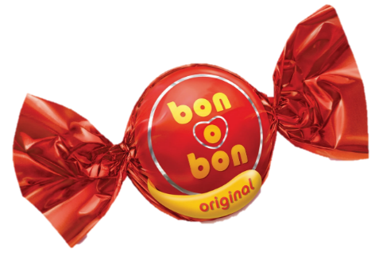
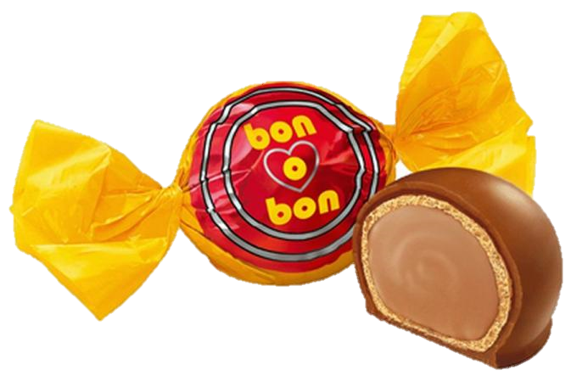
Checkback Stayman
Answers to 2♣ are:
2♦
2♥
2♠
2NT
Both majors
}
NB: One level higher after 2NT
One major
No major

Slide 16
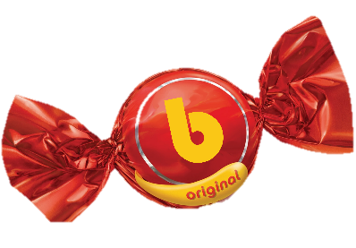
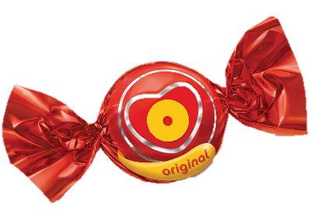


Checkback Stayman
1♣ - 1♥
1NT - 2♣
2♦
2♥
2♠
2NT
Example 1
This could be a 5 card suit
3 hearts and 4 spades
3 hearts and not 4 spades
4 spades and not 3 hearts
Neither 3 hearts nor 4 spades
NB: All responses must be alerted
Notes:
‘b’ = Both

Slide 17
Checkback Stayman
When a major has been bid by either player at the one level, they could have 5 of that suit
Therefore, if their partner has 3 of that major, it now counts in the responses.

Slide 18
Checkback Stayman
1♣ - 1♠
2NT - 3♣
3♦
3♥
3♠
3NT
Example 2
3 spades and 4 hearts
4 hearts and not 3 spades
3 spades and not 4 hearts
Neither 4 hearts nor 3 spades
NB: All responses must be alerted

Slide 19
Checkback Stayman
Opener’s rebid shows points first
If Responder bids 2♣ (or 3♣) after NT rebid, it is ALWAYS Checkback
Checkback is Game Force
Majors come next
It suits Acol very well, but can also be used in other natural systems

Slide 20
Checkback Stayman
1♣ - 1♥
1NT - 2♦
Oh no, what is this ?
Why not use Checkback to see if
Opener has 3 hearts ?
Responder is weak (5/4+) and does not like 1NT. Opener passes or corrects to 2 ♥
NB: Non forcing responses must also be alerted

Slide 21
Checkback Stayman
By not using Checkback means you have either a weak or
invitational hand
If you pass the NT rebid you are weak with no major or no 2nd suit
If you bid another suit (not Checkback) you are weak with two suits

Slide 22
Checkback Stayman
1♣ - 1♥
1NT - ?
2♦
2♥
2NT
3♣
3♥
(not 2♣)
Weak
Weak
Invite
Invite
Invite
5 hearts and 4+ diamonds
5+ hearts (probably 6)
Invitational, with only 4H
Invitational and good club fit
6+ hearts
NB: Non forcing responses must be alerted
Notes:
Suggest students add the 2NT, 3C and 3H later if they are finding this all a bit hard to pick up. Get the basic Checkback right first

Slide 23
Checkback Stayman
1♣ - 1♠
1NT - 2♣
2♦
2♥
2♠
2NT
Example 3
This could be a 5 card suit
3 spades and 4 hearts
4 hearts and not 3 spades
3 spades and not 4 hearts
Neither 4 hearts nor 3 spades
NB: All responses must be alerted

Slide 24
Checkback Stayman
1♣ - 1♦
1NT - 2♣
2♦
2♥
2♠
2NT
Example 4
4 hearts and 4 spades (very unlikely)
4 hearts and not 4 spades
4 spades and not 4 hearts
Neither 4 hearts nor 4 spades
NB: All responses must be alerted
Notes:
See if they can work out why 2D is very unlikely. If they do bid this, it means the hand is 4-4-1-4 (unless they open with 3+ clubs)

Slide 25
Checkback Stayman
1♥ - 1♠
1NT - 2♣
2♦
2♥
2♠
2NT
Example 5
…and so could this
Not in the Student Notes
This could be a 5 card suit
5 hearts and 3 spades
5 hearts and not 3 spades
3 spades and 4 hearts
Neither 5 hearts nor 3 spades
NB: All responses must be alerted

Slide 26

Checkback Stayman
RECAP
Both – One – None
If Responder does not have enough for game after Opener’s NT rebid
Do not use Checkback
either PASS or show a weak 2-suiter hand

Slide 27

Checkback Stayman
RECAP
If Opener bids 2♦ (or 3♦) after Checkback, they have both majors in some form or another
If Opener and/or Responder bids a major at the 1-level, a 3 major now counts in the 2♦ or (3♦) response

Slide 28
INTERMEDIATE LESSONS
Please contact me if you have any questions
Teacher: Your Name Here
Telephone: 123 4567
Email: email@address.co.nz
Education is not the learning of facts,
but the training of the mind to think.
- Albert Einstein

