Slide 1
INTERMEDIATE LESSON
Welcome
Your logo here
Teacher: ?
Telephone: xxx
Email: xxx@xtra.co.nz

Slide 2
1NT - (2 of a suit overcall)
Combating Interference over our 1NT
now what?
Prepared by Pam Livingston and kindly shared with NZBridge
Notes:
Series put together by NZ Bridge
All available on NZ Bridge website
Copy of the powerpoint email me

Slide 3
Combating Interference over our 1NT
1NT (2♠) your bid …
Hand 1
♠73
♥KQJT43
♦763
♣Q3
Hand 2
♠73
♥Q8743
♦AQ3
♣KQ3
Prepared by Pam Livingston and kindly shared with NZBridge

Slide 4
Combating Interference over our 1NT
Some of our bidding space has been used up
Some of our tools have been taken away from us eg stayman, transfers, rangefinder
We need to have a new set of tools
Prepared by Pam Livingston and kindly shared with NZBridge

Slide 5
Combating Interference over our 1NT
Lebensohl is an artificial relay bid of 2NT
1NT (2 of a suit) 2NT
When 2NT is bid in this situation it is no longer a natural bid – remember to alert it ☺
2NT now means “Partner you must bid 3♣” – remember to alert the 3♣ bid as it is also artificial
Prepared by Pam Livingston and kindly shared with NZBridge

Slide 6
Lebensohl
Combating Interference over our 1NT
1NT - (2 suit) - 2NT - (pass) - 3♣
After 3♣ by Opener (which they are forced to bid), pass or bid your suit.
If your suit is a lower rank suit to the opposition’s it is not forcing
If your suit is a higher rank suit to the opposition’s it is invitational
Prepared by Pam Livingston and kindly shared with NZBridge

Slide 7
Combating Interference over our 1NT
Our new set of tools
Pass No 5+ card suit to show and/or few HCP
X (our new stayman) Takeout with accent on the majors
2 level bid 6-9 hcp 5+ suit, non forcing
2nt (our new transfer to any suit) Lebensohl
3 level bid game force with a 5+ suit
3 opps suit game force asking for a hold in their suit
3nt game values with a stop in their suit
Prepared by Pam Livingston and kindly shared with NZBridge

Slide 8
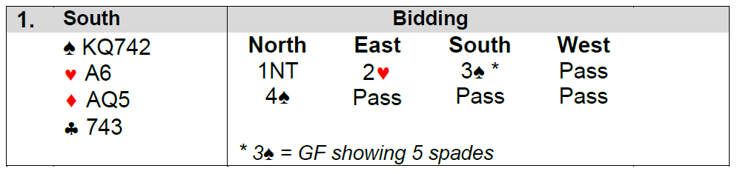
Combating Interference over our 1NT
Examples
Prepared by Pam Livingston and kindly shared with NZBridge

Slide 9
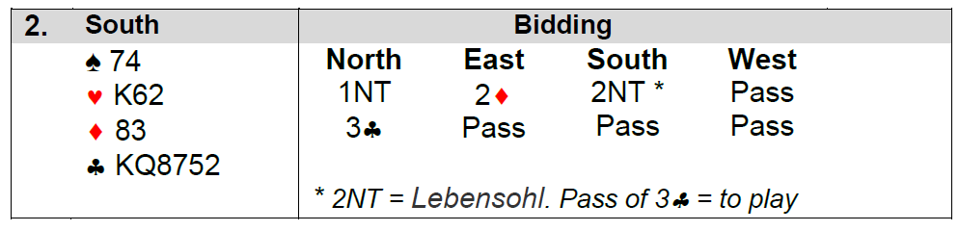
Combating Interference over our 1NT
Examples
Prepared by Pam Livingston and kindly shared with NZBridge

Slide 10
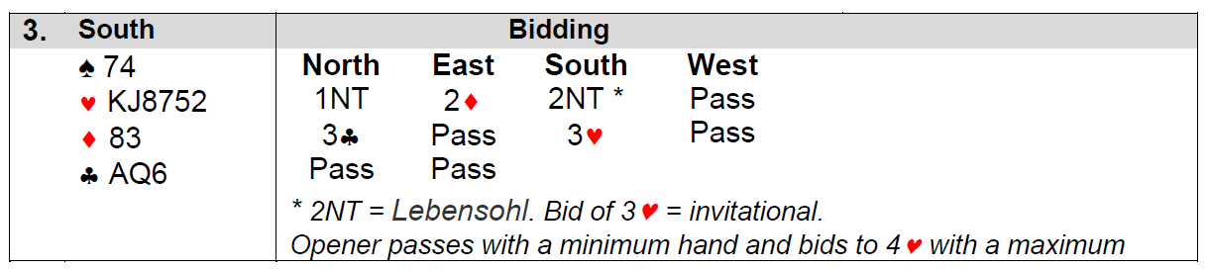
Combating Interference over our 1NT
Examples
Prepared by Pam Livingston and kindly shared with NZBridge

Slide 11
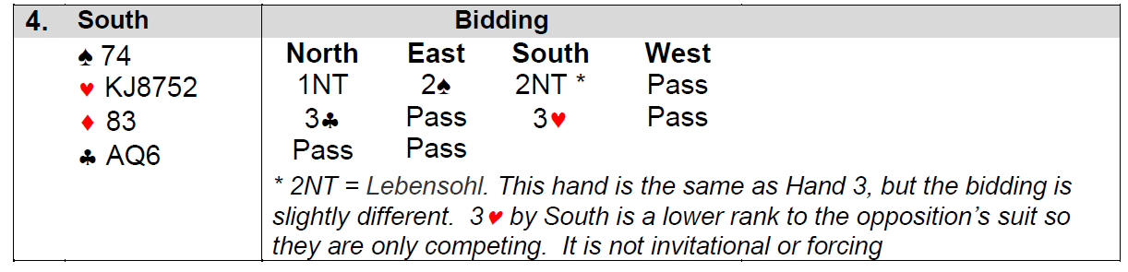
Combating Interference over our 1NT
Examples
Prepared by Pam Livingston and kindly shared with NZBridge

Slide 12
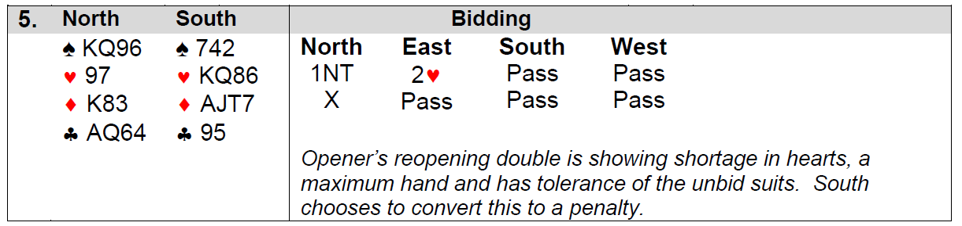
Combating Interference over our 1NT
Examples
Prepared by Pam Livingston and kindly shared with NZBridge

Slide 13
INTERMEDIATE LESSON
Have fun !
Your logo here
Teacher: ?
Telephone: xxx
Email: xxx@xtra.co.nz

