Slide 1

BEGINNERS’ LESSONS
Welcome
Teacher: Your Name Here
Telephone: 123 4567
Email: email@address.co.nz

Slide 2
Lesson Seven
Overcalls

Slide 3
Reasons for Overcalling
To get into the bidding … make it hard for the opposition
Express a genuine desire to play in a suit
Suggest a lead for partner

Slide 4
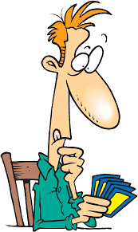
Rules to Overcall a suit
MUST be a good 5+ card suit – at least 2 honours
Point count should be close to opening values if overcalling at the 2-level

Slide 5
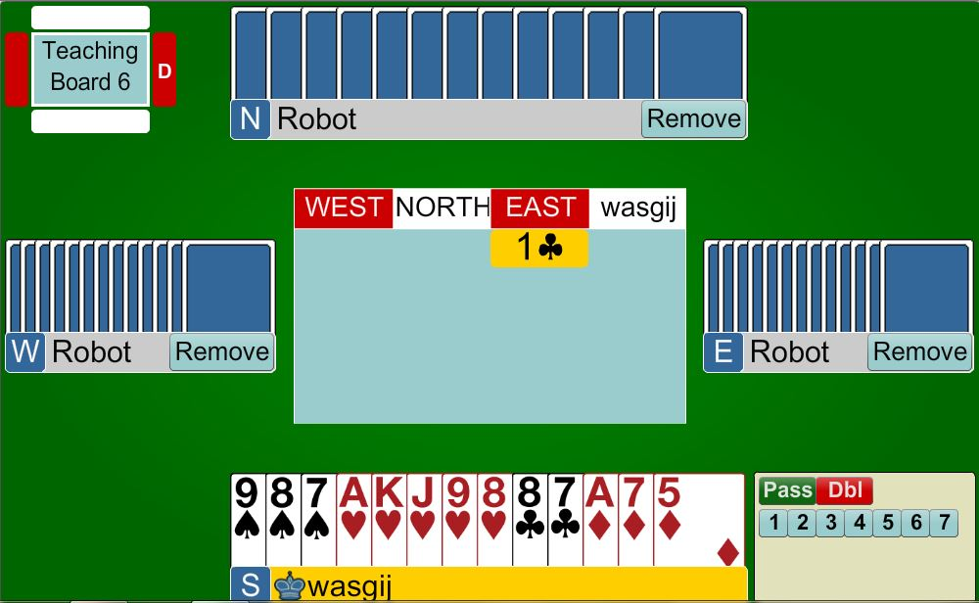

Overcalling a suit
PARTNER
1♥
South has an Opening Hand with a GOOD 5-card suit
(at least two honours in the suit)
HIM
HER
YOU

Slide 6
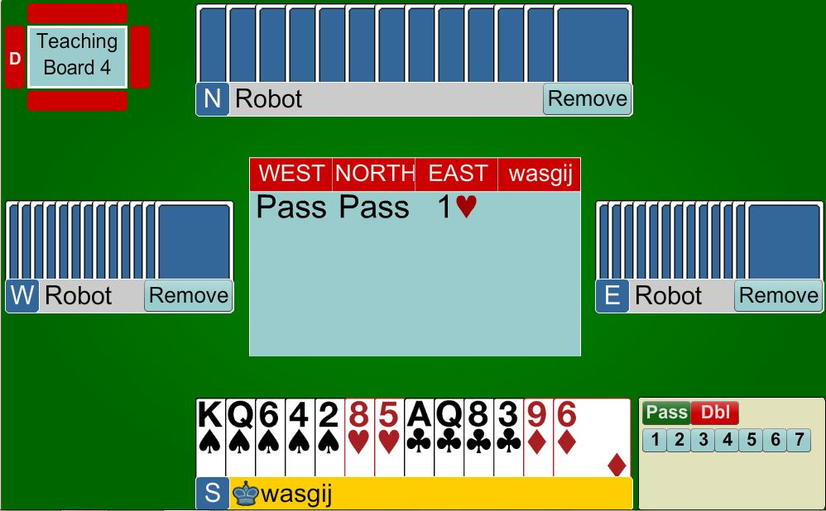
Overcalling a suit
PARTNER
1♠
South has an Opening Hand with a GOOD 5-card suit
(at least two honours in the suit)
HIM
HER
YOU

Slide 7
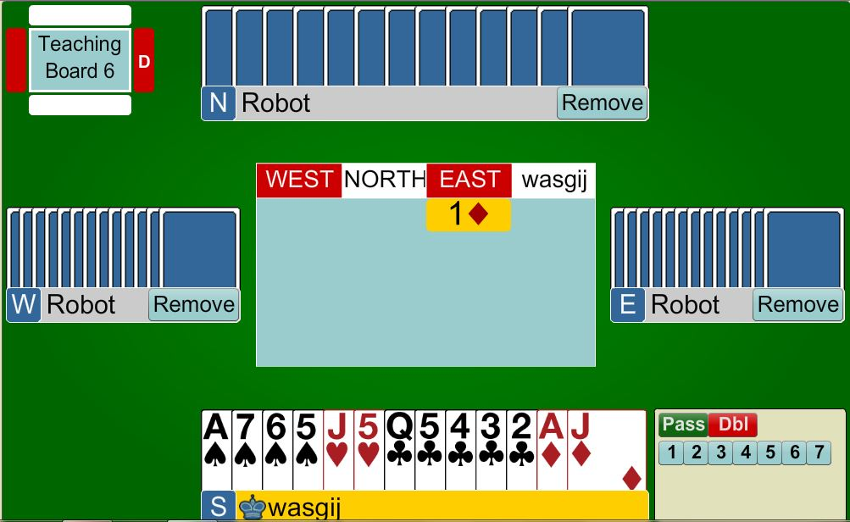
Overcalling a suit
PARTNER
PASS
Opening Hand BUT a poor suit
DO NOT BE TEMPTED to overcall
HIM
HER
YOU

Slide 8
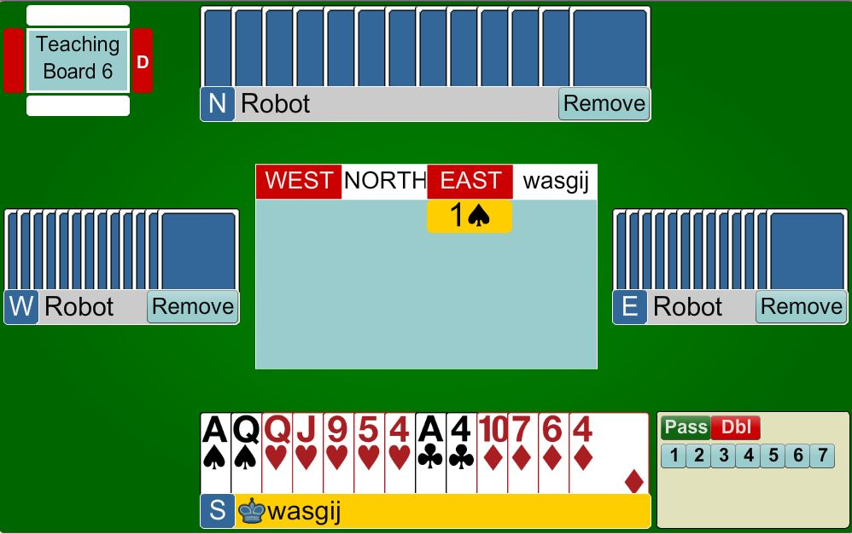

Overcalling a suit
PARTNER
2♥ or PASS
Opening Hand. Suit OK.
Bidding will make it very
difficult for the opposition
but could be risky
HIM
HER
YOU

Slide 9
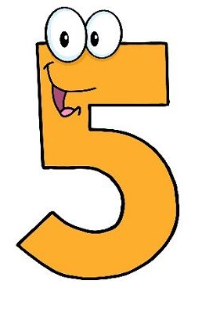
Response to Overcall of a suit
Only bid with a fit (3+ support)
Support partner if you can … keeping
in mind that partner has shown
of the suit – need 6+ points
With 12+ points, jump in partner’s suit

Slide 10
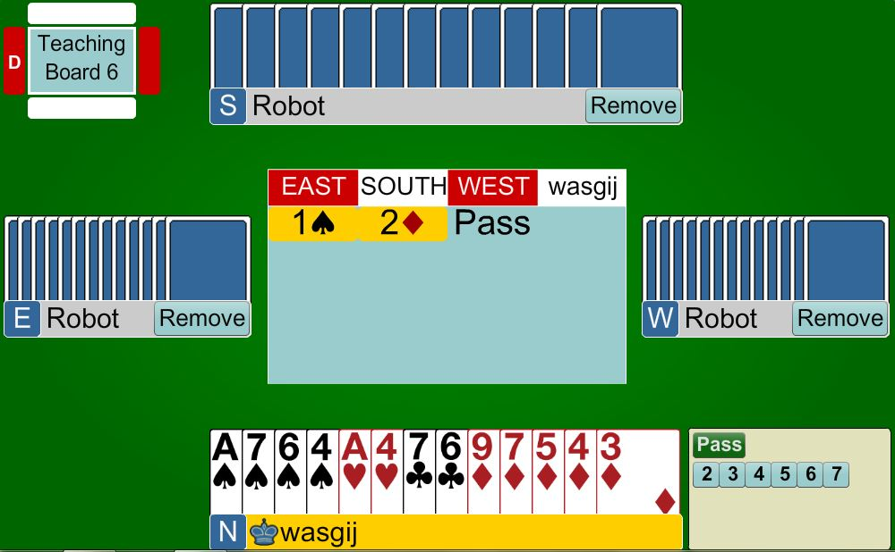
Response to a suit overcall
PARTNER
3♦
Show a minimum raise
Mainly to make it as hard as possible for the opposition … you have a 10-card fit in diamonds
HIM
HER
YOU

Slide 11
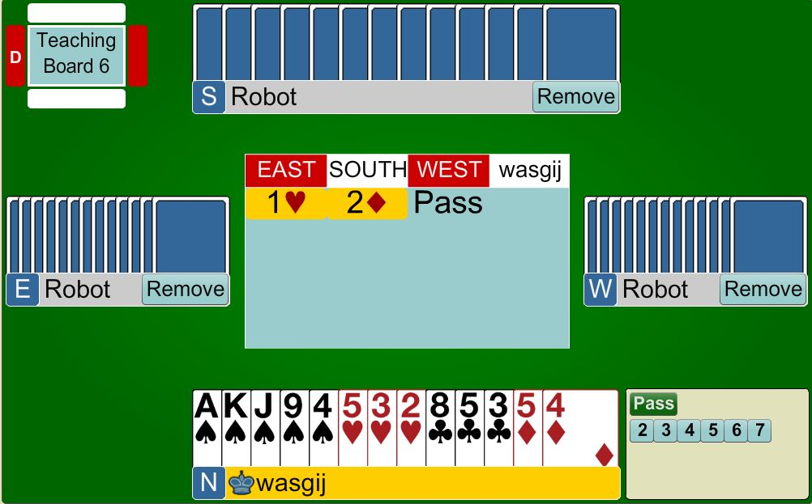
Response to a suit overcall
PARTNER
PASS
Cannot support diamonds
DO NOT bid the spade suit as your hand is not good enough
HIM
HER
YOU

Slide 12
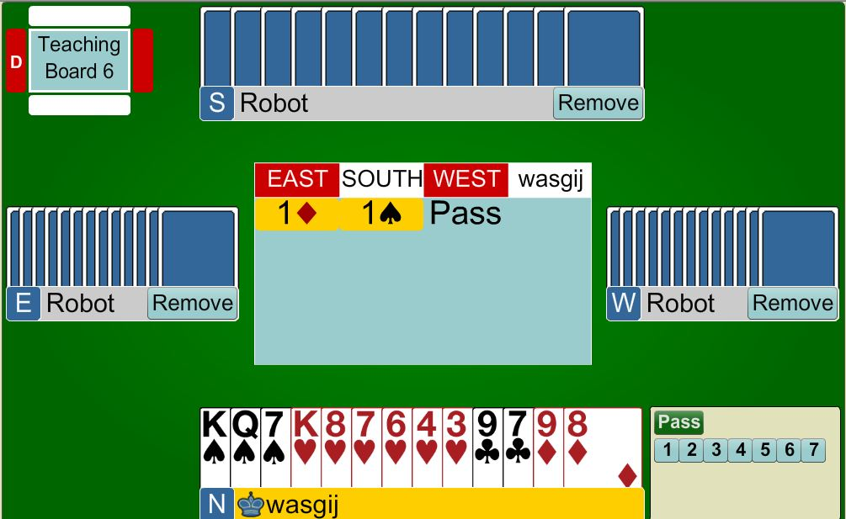
Response to a suit overcall
PARTNER
2♠
Support partner’s 5-card spade suit
You have a fit
Ignore your own heart suit
HIM
HER
YOU

Slide 13

Rules to Overcall in NoTrumps
Need BETTER points than opening 1NT
  16 – 18 points
MUST have a cover in the
opposition’s suit

Slide 14
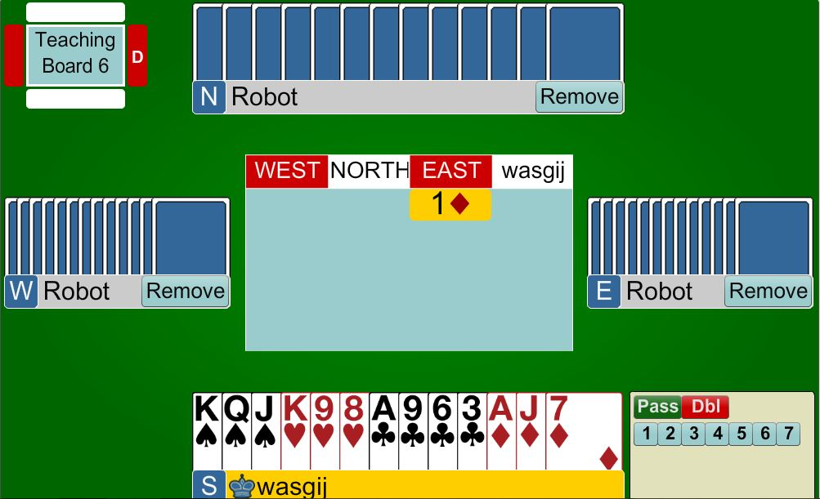
Overcalling
1NT
PARTNER
1NT
18 points
balanced hand with a diamond hold
HIM
HER
YOU

Slide 15
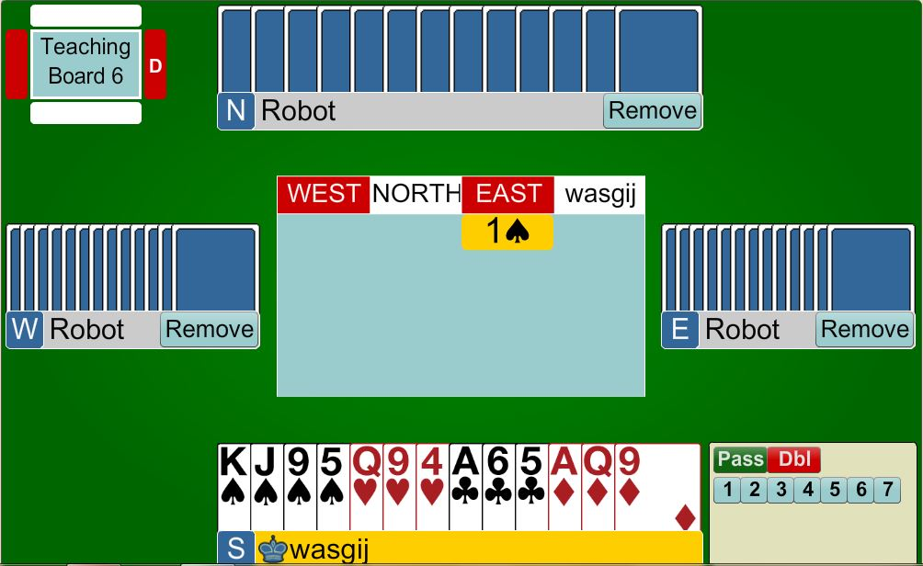
Overcalling
1NT
PARTNER
1NT
16 points
balanced hand with a spade hold
HIM
HER
YOU

Slide 16
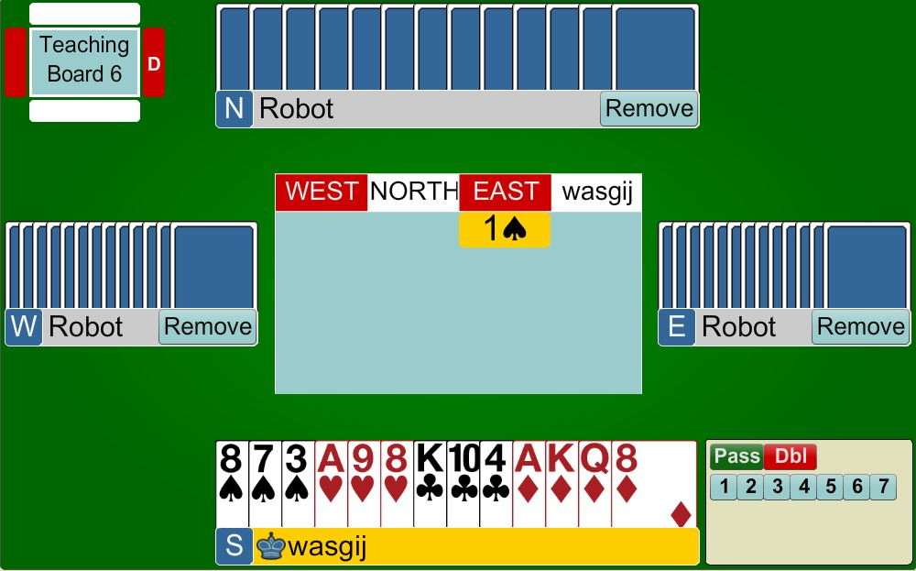
Overcalling
1NT
PARTNER
PASS
16 points
balanced hand BUT no spade hold
You cannot overcall 1NT
HIM
HER
YOU

Slide 17
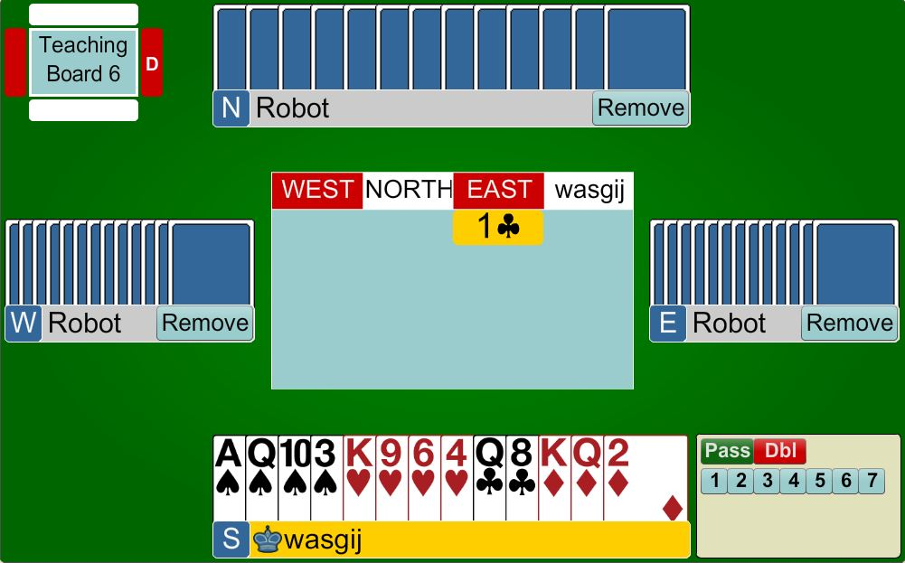
Overcalling
1NT
PARTNER
NEXT WEEK’S LESSON !
?
16 points
balanced hand BUT no club hold
You cannot overcall 1NT
HIM
HER
YOU

Slide 18
Response to Overcall of 1NT
Unbalanced Hand
Use same responses as for opening
1 NT … BUT adjust point count
  0 – 7 points – bid your own suit
  8+ points – bid your 5-card suit (major) at 3-level or bid your 6-card suit at GAME

Slide 19
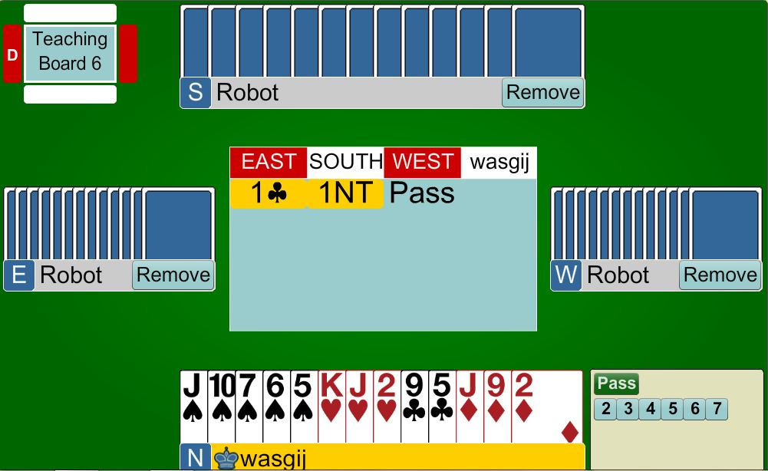
Response to 1NT overcall
PARTNER
2♠
Unbalanced hand
not enough points for game, therefore, bid your long suit (weak takeout)
HIM
HER
YOU

Slide 20
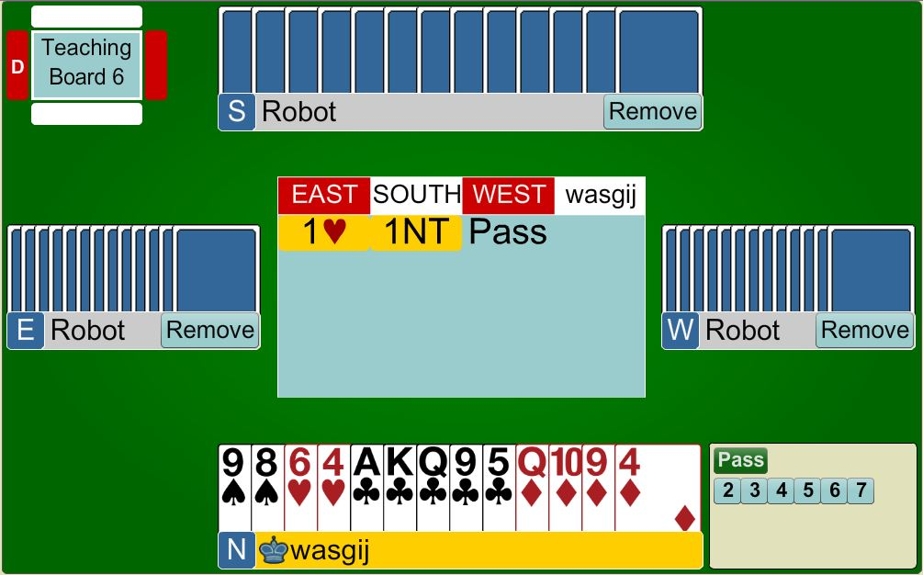
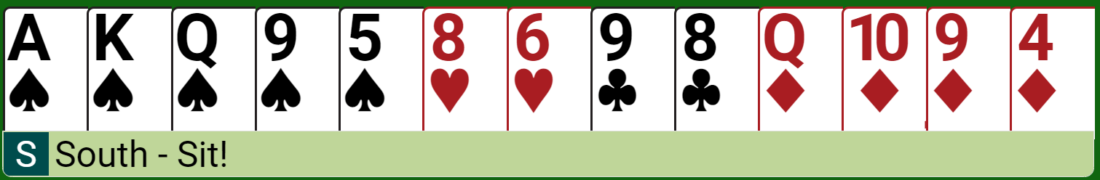
Response to 1NT overcall
PARTNER
3♠
UNBALANCED HAND
with points for GAME
Show your 5-card suit by bidding
at the 3-level
HIM
HER
YOU

Slide 21

Response to Overcall of 1NT
Balanced Hand
  0 – 7 points – PASS
  8 points – 2NT (inviting to game)
  9+ points – 3NT (wanting to be in game)

Slide 22
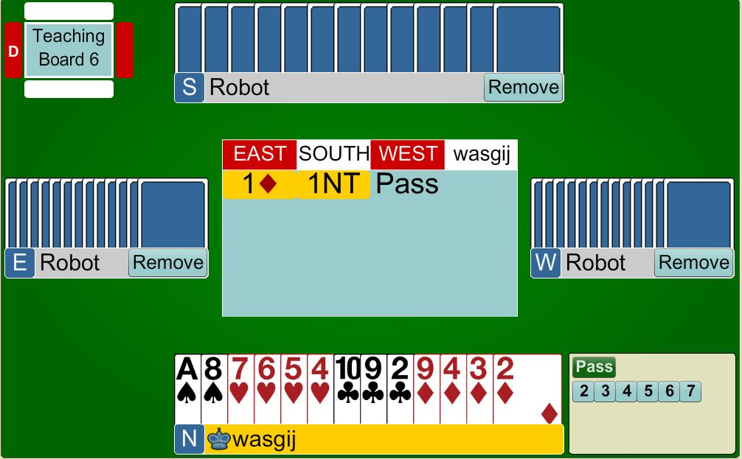
Response to 1NT overcall
PARTNER
PASS
BALANCED HAND
not enough points for game, therefore, PASS
HIM
HER
YOU

Slide 23

Response to Overcall of 1NT
PARTNER
3NT
BALANCED HAND
points for game
bid 3NT
HIM
HER
YOU

Slide 24
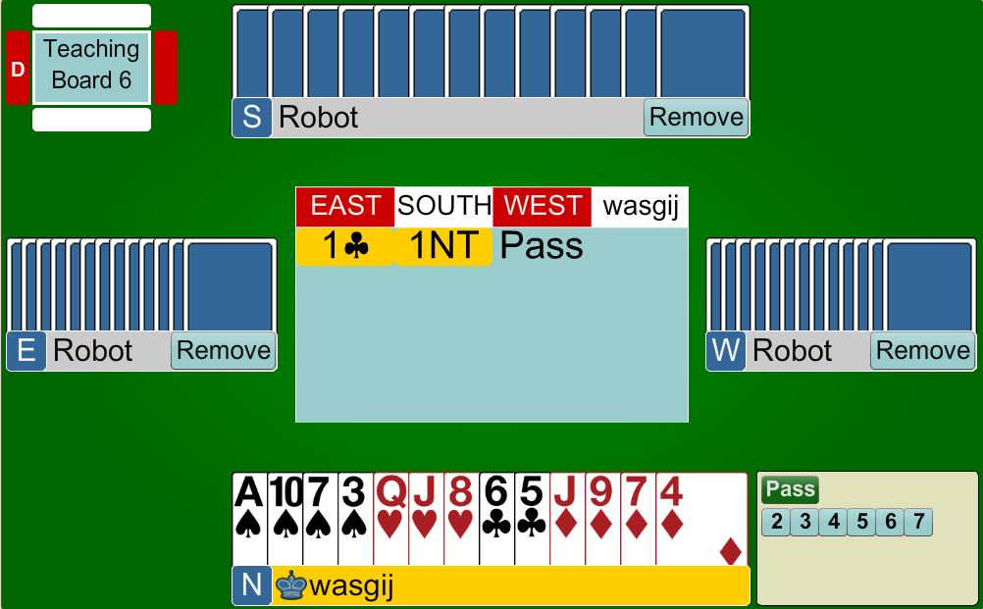
Response to 1NT overcall
PARTNER
2NT
BALANCED HAND
with 8 points you are close to game. 2NT invites partner. If they have 17 or 18 they bid to game
HIM
HER
YOU

Slide 25
BEGINNERS’ LESSONS
any questions please ask
Teacher: TEACHER NAME HERE
Telephone: PHONE
Email: EMAIL

