Slide 1

BEGINNERS’ LESSONS
Welcome
Teacher: Your Name Here
Telephone: 123 4567
Email: email@address.co.nz

Slide 2
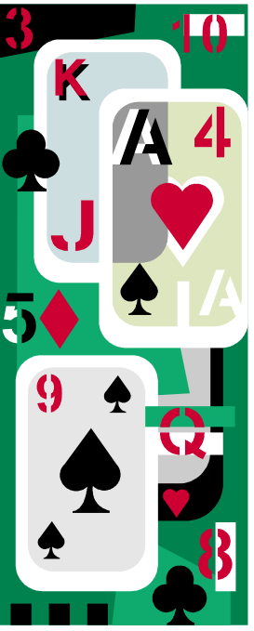
PLAYING TIPS
Ruffing in Dummy

Slide 3


Play of the Hand – Trump Contracts
Draw trumps first
Remember to count how many trumps are left out
STOP drawing trumps when:
  Only the highest trump is left OR
  Your Opponents trumps have run out
BUT … There is an EXCEPTION

Slide 4

Play of the Hand – Trump Contracts
If dummy has a shortage in a side suit you may be able to score extra tricks by ruffing with dummy’s trumps
THIS MEANS YOU CAN’T DRAW ALL THE TRUMPS STRAIGHT AWAY

Slide 5
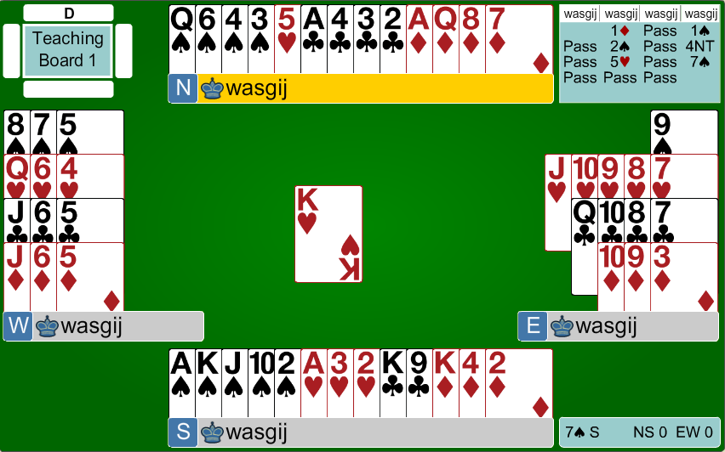


Slide 6


Contract = 7♠, Lead = ♥K
We have 11 sure tricks … we have to make 2 more tricks
How do we make all the tricks?

Slide 7
Contract = 7♠, Lead = ♥K
We have 2 heart losers so we must ruff them both with dummy’s trumps
How do we make all the tricks?

Slide 8
Contract = 7♠, Lead = ♥K
We must do this before drawing trumps otherwise we might not have enough trumps left in dummy
How do we make all the tricks?

Slide 9
Contract = 7♠, Lead = ♥K
Win the first trick with ♥A then ruff the ♥2, come back to the ♠A and ruff the ♥3 with the ♠Q (to be safe)
How do we make all the tricks?

Slide 10
Contract = 7♠, Lead = ♥K
Then finish drawing trumps then you have all the winners ☺
How do we make all the tricks?

Slide 11

BEGINNERS’ LESSONS
Please contact me if you have any questions
Teacher: Your Name Here
Telephone: 123 4567
Email: email@address.co.nz

