Slide 1
Board Update
AGM Hamilton
28th September 2019

Slide 2

The year so far:
Constitutional review
Communications & Marketing
NZB Website
Education
Strategies to grow the game
Etiquette & conduct
Other matters

Slide 3
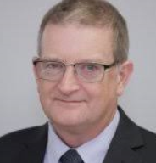
Constitutional Review
Review committee chaired by John Skipper
Broad consultation with discussion at National Conference and
Board proposing the adoption of new constitution designed to govern the organisation for the next 10 years and beyond
Major agenda item at this AGM
If adopted, next body of work will be a comprehensive review of the NZB manual

Slide 4
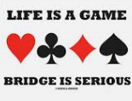
Communications & Marketing
Long term strategy: “Bridge a game for life”
Key objective to increase reach
Wider marketing strategy
  Non-affiliated clubs
  Social players
  Businesses
Marketing sub-committee – looking for people with marketing, advertising or PR skills and contacts

Slide 5
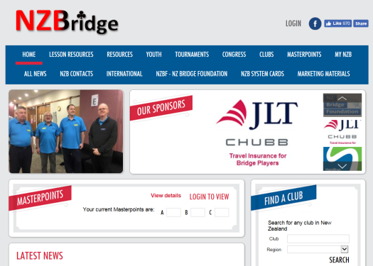
NZB Website
Facilitating access and participation
Majority of clubs now have tournament entry through NZB website
  Positive feedback from players and clubs
  Updated so changes cannot be made after entries close (players have to contact host club now)
Improving the accuracy and utility of masterpoint and player records
  Building an automated transfer function for AU awards
  Reworking Baden Wilson and Ranks results
  Corrections to players certificate criteria. Includes high resolution logo to improve print quality
  Improvements to player search function
  Historical player records transferred from original system

Slide 6
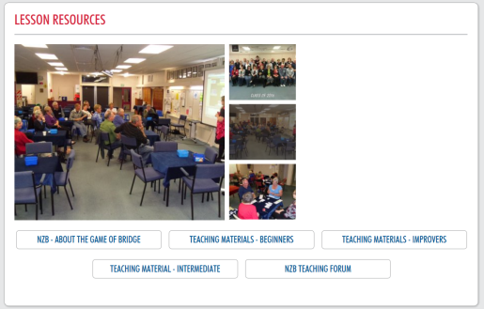
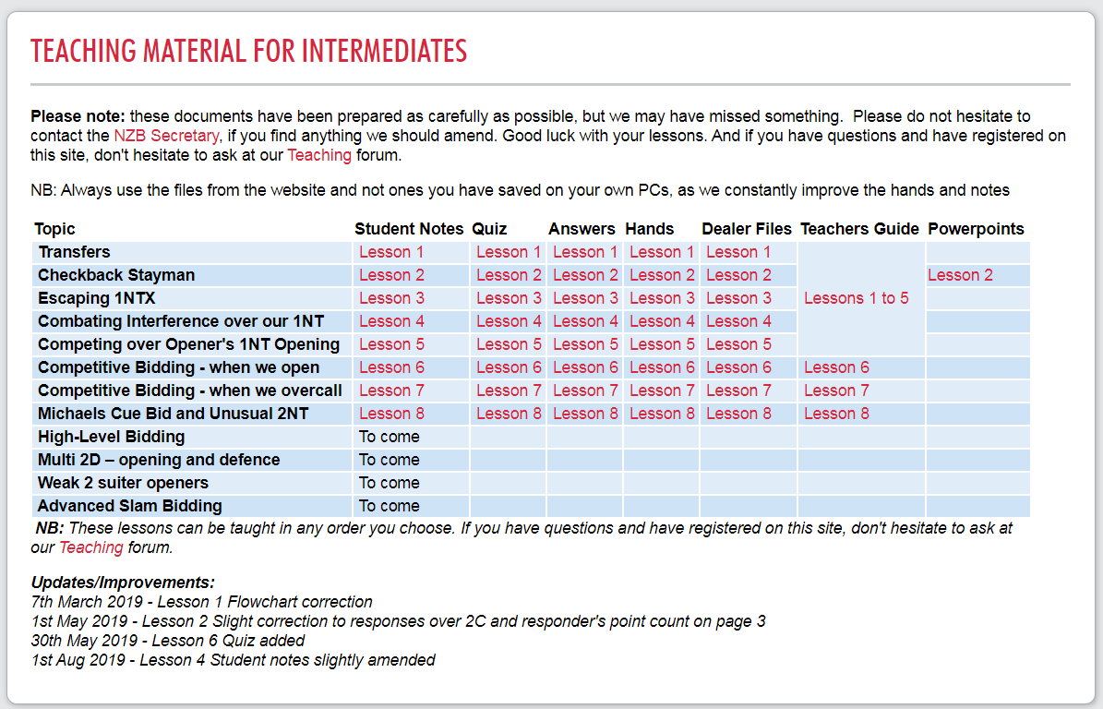
Education
Lessons and education a continued focus
Teacher’s Group continues to develop and refine materials
  Improver lessons reviewed and completed
  8 Intermediate lessons completed and 4 more started
Successful Teachers conference held in Wellington on 16th and 17th August
Where to from here ? Partnership lessons and Advanced lessons ?

Slide 7
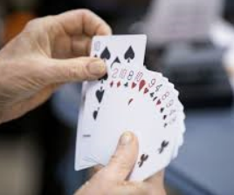
Strategies to grow the game
Importance of growth in playing numbers & participation
Regional Bridge Mates central to local growth – delivered and exceeded all milestones
Playing numbers and participation good at clubs, tournaments and for IP trials
5-year Youth Strategy to nurture the next generation. 2019 goals:
  Regional Youth representatives
  Lessons for schools
  NZB and Duke of Edinburgh awards in schools and clubs
  Jan France appointed to lead this strategy

Slide 8
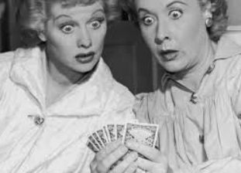
Etiquette and conduct
The best course of action is to behave correctly and appropriately at the table and ensure your conduct away from the table is exemplary
Inappropriate behaviour can have a detrimental impact on the game and on players
We know we can lose players if they have a bad experience early in their bridge life
Experienced players must act professionally, ethically and beyond reproach at all times
If a situation arises players must immediately report it to the director and recorder (as relevant)
STOP AND THINK BEFORE YOU SAY OR DO ANYTHING

Slide 9
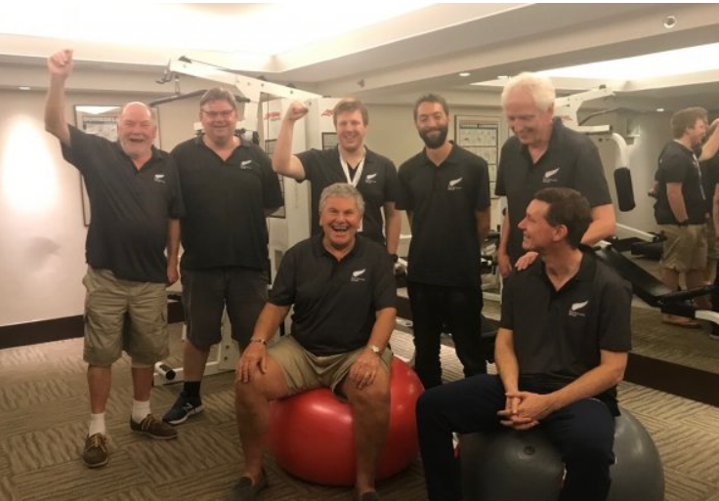
Other matters
Regional committees and their ongoing role
Developing funding strategies
Health and safety policy
Child protection policy
APBF Silver for the Bridge Blacks

